Slide 1

Reading Group: Recursive Estimation of Time-Average Variance Constants (Wu, 2009)
Heman Leung
Spring, 2020

Slide 2
Introduction
Section 1

Slide 3
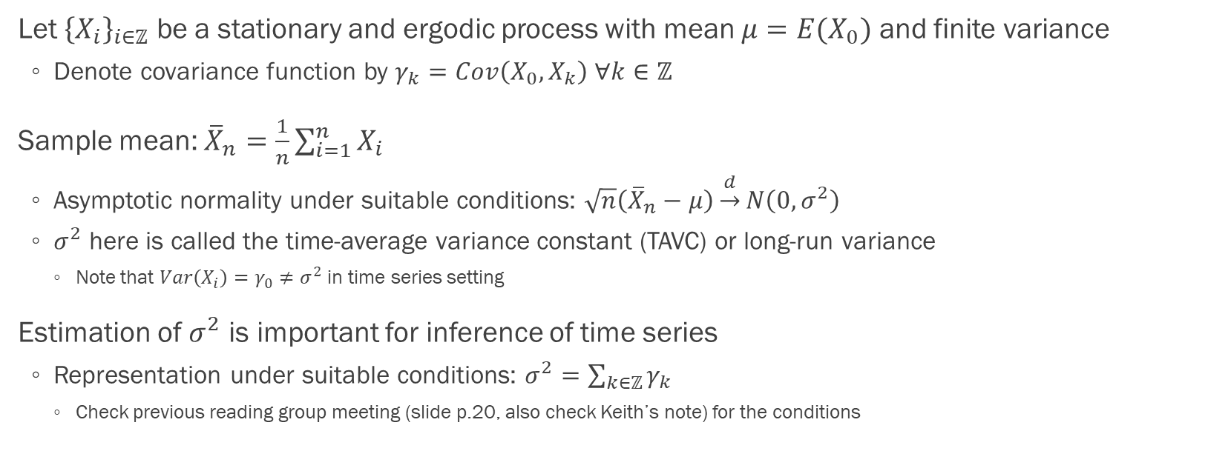
Time-average variance constant (p.1)
Let ${\left\{X_{i}\right\}}_{i∈ℤ}$ be a stationary and ergodic process with mean $μ=E(X_{0})$ and finite variance
Denote covariance function by $γ_{k}=Cov\left(X_{0},X_{k}\right) ∀k∈ℤ$
Sample mean: ${\overline{X}}_{n}=\frac{1}{n}\sum_{i=1}^{n}{X_{i}}$
Asymptotic normality under suitable conditions: $\sqrt{n}\left({\overline{X}}_{n}−μ\right)\underset{→}{d}N\left(0,σ^{2}\right)$
$σ^{2}$ here is called the time-average variance constant (TAVC) or long-run variance
Note that $Var\left(X_{i}\right)=γ_{0}≠σ^{2}$ in time series setting
Estimation of $σ^{2}$ is important for inference of time series
Representation under suitable conditions: $σ^{2}=\sum_{k∈ℤ}{γ_{k}}$
Check previous reading group meeting (slide p.20, also check Keith’s note) for the conditions

Slide 4
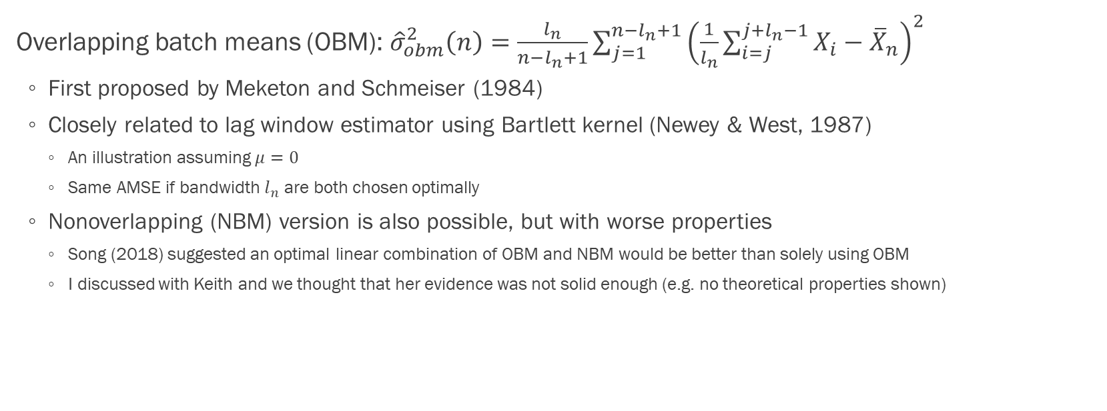
Overlapping batch means (p.2)
Overlapping batch means (OBM): ${\hat{σ}}_{obm}^{2}\left(n\right)=\frac{l_{n}}{n−l_{n}+1}\sum_{j=1}^{n−l_{n}+1}{{\left(\frac{1}{l_{n}}\sum_{i=j}^{j+l_{n}−1}{X_{i}−{\overline{X}}_{n}}\right)}^{2}}$
First proposed by Meketon and Schmeiser (1984)
Closely related to lag window estimator using Bartlett kernel (Newey & West, 1987)
An illustration assuming $μ=0$
Same AMSE if bandwidth $l_{n}$ are both chosen optimally
Nonoverlapping (NBM) version is also possible, but with worse properties
Song (2018) suggested an optimal linear combination of OBM and NBM would be better than solely using OBM
I discussed with Keith and we thought that her evidence was not solid enough (e.g. no theoretical properties shown)

Slide 5
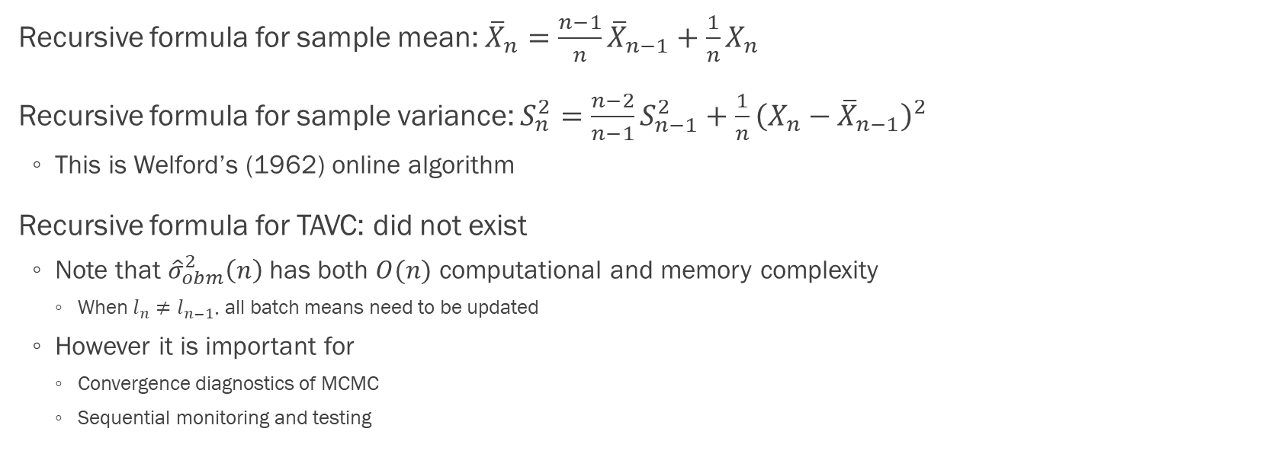
Recursive estimation
Recursive formula for sample mean: ${\overline{X}}_{n}=\frac{n−1}{n}{\overline{X}}_{n−1}+\frac{1}{n}X_{n}$
Recursive formula for sample variance: $S_{n}^{2}=\frac{n−2}{n−1}S_{n−1}^{2}+\frac{1}{n}{\left(X_{n}−{\overline{X}}_{n−1}\right)}^{2}$
This is Welford’s (1962) online algorithm
Recursive formula for TAVC: did not exist
Note that ${\hat{σ}}_{obm}^{2}\left(n\right)$ has both $O(n)$ computational and memory complexity
When $l_{n}≠l_{n−1}$, all batch means need to be updated
However it is important for
Convergence diagnostics of MCMC
Sequential monitoring and testing

Slide 6
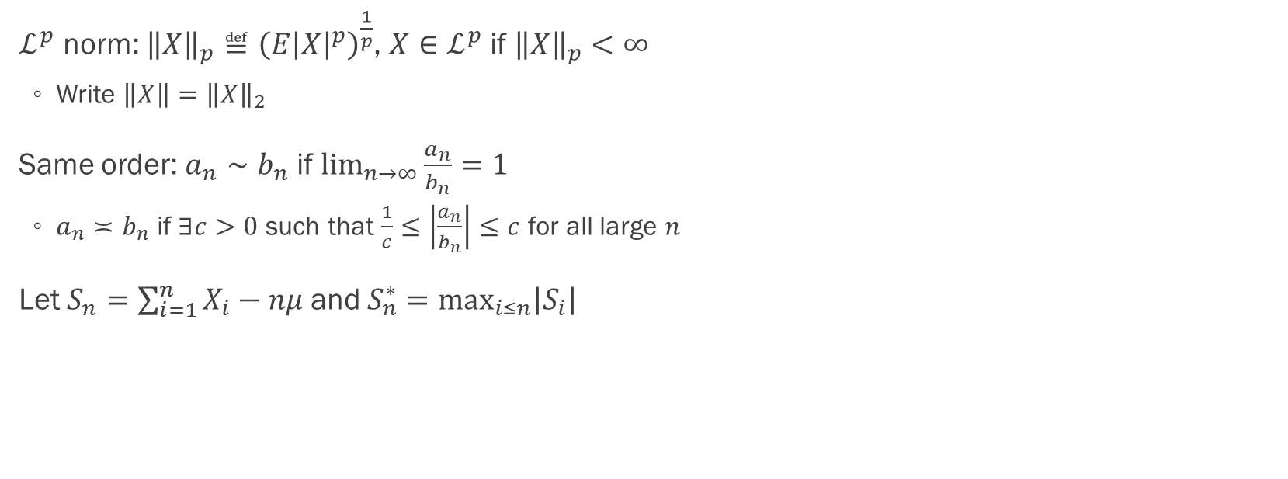
Notations (p.3)
$ℒ^{p}$ norm: ${\left\|X\right\|}_{p}≝{\left(E{\left|X\right|}^{p}\right)}^{\frac{1}{p}}$, $X∈ℒ^{p}$ if ${\left\|X\right\|}_{p}<∞$
Write $\left\|X\right\|={\left\|X\right\|}_{2}$
Same order: $a_{n}∼b_{n}$ if $\lim_{n→∞}{\frac{a_{n}}{b_{n}}}=1$
$a_{n}≍b_{n}$ if $∃c>0$ such that $\frac{1}{c}≤\left|\frac{a_{n}}{b_{n}}\right|≤c$ for all large $n$
Let $S_{n}=\sum_{i=1}^{n}{X_{i}}−nμ$ and $S_{n}^{∗}=\max_{i≤n}\left|S_{i}\right|$

Slide 7
Recursive TAVC estimates
Section 2

Slide 8
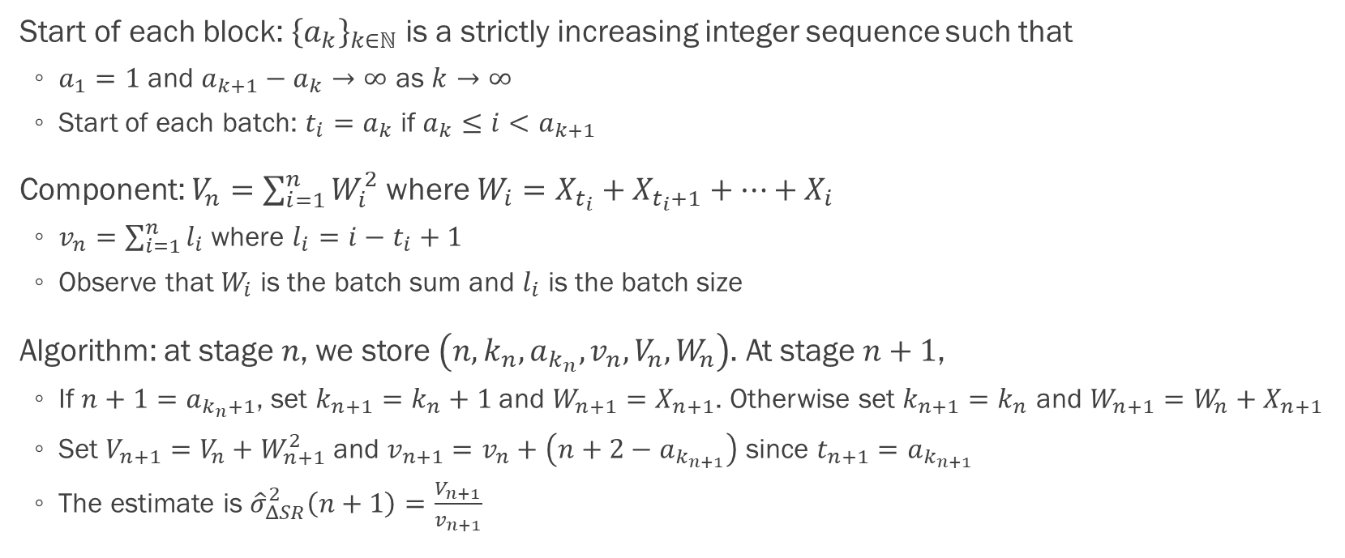

Algorithm when $μ=0$
Start of each block: ${\left\{a_{k}\right\}}_{k∈ℕ}$ is a strictly increasing integer sequence such that
$a_{1}=1$ and $a_{k+1}−a_{k}→∞$ as $k→∞$
Start of each batch: $t_{i}=a_{k}$ if $a_{k}≤i<a_{k+1}$
Component: $V_{n}=\sum_{i=1}^{n}{W_{i}^{2}}$ where $W_{i}=X_{t_{i}}+X_{t_{i}+1}+…+X_{i}$
$v_{n}=\sum_{i=1}^{n}{l_{i}}$ where $l_{i}=i−t_{i}+1$
Observe that $W_{i}$ is the batch sum and $l_{i}$ is the batch size
Algorithm: at stage $n$, we store $\left(n,k_{n},a_{k_{n}},v_{n},V_{n},W_{n}\right)$. At stage $n+1$,
If $n+1=a_{k_{n}+1}$, set $k_{n+1}=k_{n}+1$ and $W_{n+1}=X_{n+1}$. Otherwise set $k_{n+1}=k_{n}$ and $W_{n+1}=W_{n}+X_{n+1}$
Set $V_{n+1}=V_{n}+W_{n+1}^{2}$ and $v_{n+1}=v_{n}+\left(n+2−a_{k_{n+1}}\right)$ since $t_{n+1}=a_{k_{n+1}}$
The estimate is ${\hat{σ}}_{ΔSR}^{2}\left(n+1\right)=\frac{V_{n+1}}{v_{n+1}}$

Slide 9
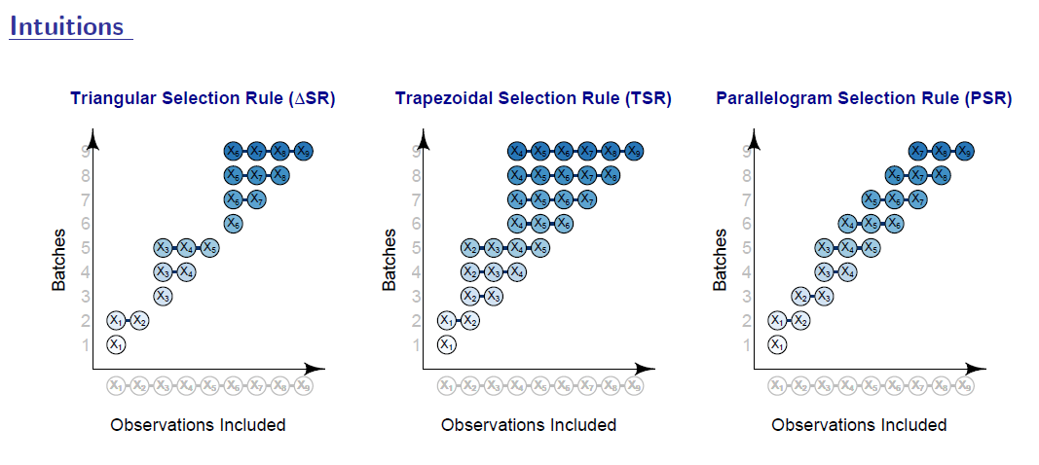
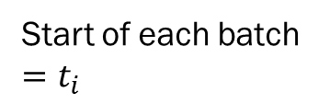
Graphical illustration (Chan and Yau, 2017)
Start of each batch $=t_{i}$
Start of each block $=a_{k}$; thus a block $B_{k}$ contains $\left\{a_{k},a_{k}+1,…,a_{k+1}−1\right\}$

Slide 10
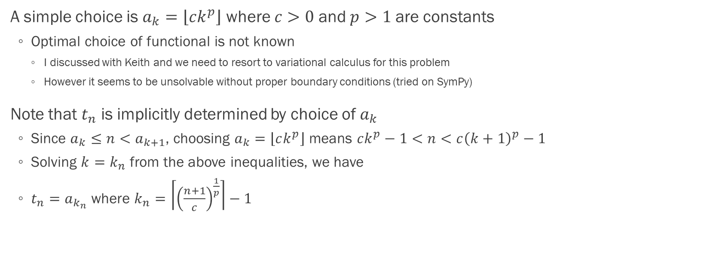

Choice of $a_{k}$ and $t_{n}$ (p.3-4)
A simple choice is $a_{k}=\left\lfloor ck^{p}\right\rfloor$ where $c>0$ and $p>1$ are constants
Optimal choice of functional is not known
I discussed with Keith and we need to resort to variational calculus for this problem
However it seems to be unsolvable without proper boundary conditions (tried on SymPy)
Note that $t_{n}$ is implicitly determined by choice of $a_{k}$
Since $a_{k}≤n<a_{k+1}$, choosing $a_{k}=\left\lfloor ck^{p}\right\rfloor$ means $ck^{p}−1<n<c{\left(k+1\right)}^{p}−1$
Solving $k=k_{n}$ from the above inequalities, we have
$t_{n}=a_{k_{n}}$ where $k_{n}=\left\lceil {\left(\frac{n+1}{c}\right)}^{\frac{1}{p}}\right\rceil −1$

Slide 11
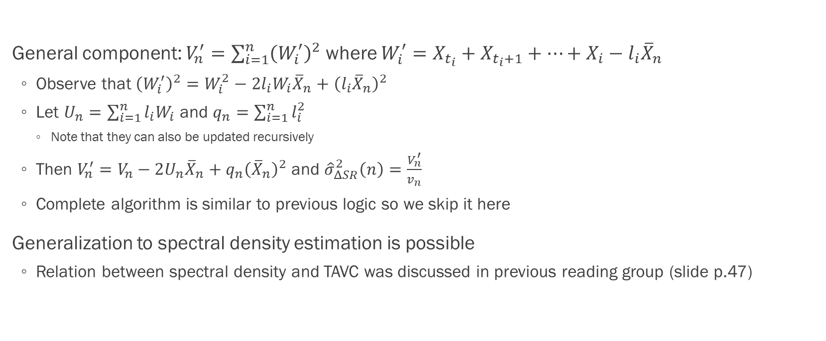
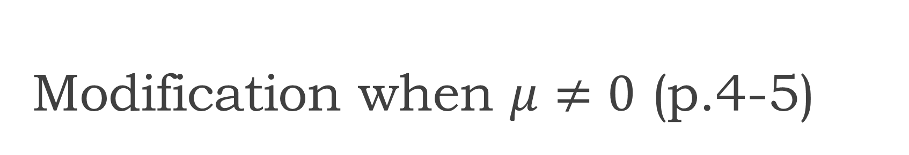
Modification when $μ≠0$ (p.4-5)
General component: $V_{n}^{′}=\sum_{i=1}^{n}{{\left(W_{i}^{′}\right)}^{2}}$ where $W_{i}^{′}=X_{t_{i}}+X_{t_{i}+1}+…+X_{i}−l_{i}{\overline{X}}_{n}$
Observe that ${\left(W_{i}^{′}\right)}^{2}=W_{i}^{2}−2l_{i}W_{i}{\overline{X}}_{n}+{\left(l_{i}{\overline{X}}_{n}\right)}^{2}$
Let $U_{n}=\sum_{i=1}^{n}{l_{i}W_{i}}$ and $q_{n}=\sum_{i=1}^{n}{l_{i}^{2}}$
Note that they can also be updated recursively
Then $V_{n}^{′}=V_{n}−2U_{n}{\overline{X}}_{n}+q_{n}{\left({\overline{X}}_{n}\right)}^{2}$ and ${\hat{σ}}_{ΔSR}^{2}\left(n\right)=\frac{V_{n}^{′}}{v_{n}}$
Complete algorithm is similar to previous logic so we skip it here
Generalization to spectral density estimation is possible
Relation between spectral density and TAVC was discussed in previous reading group (slide p.47)

Slide 12
Convergence properties
Section 3

Slide 13
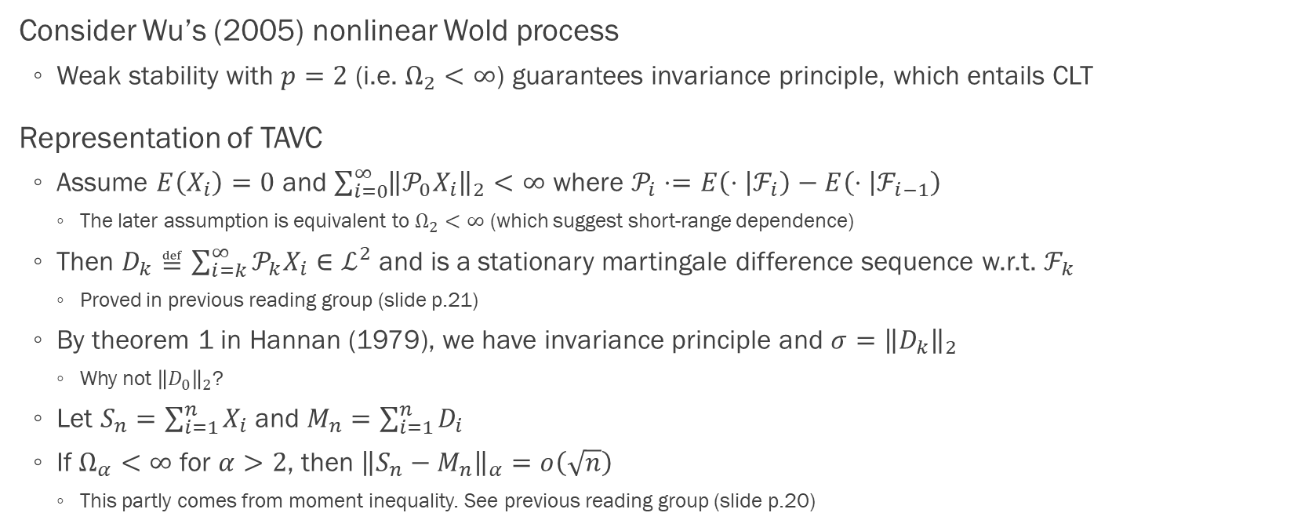
Representation of TAVC (p.5-6)
Consider Wu’s (2005) nonlinear Wold process
Weak stability with $p=2$ (i.e. $Ω_{2}<∞$) guarantees invariance principle, which entails CLT
Representation of TAVC
Assume $E\left(X_{i}\right)=0$ and $\sum_{i=0}^{∞}{{\left\|𝒫_{0}X_{i}\right\|}_{2}}<∞$ where $𝒫_{i}⋅=E\left(⋅ | ℱ_{i}\right)−E\left(⋅ | ℱ_{i−1}\right)$
The later assumption is equivalent to $Ω_{2}<∞$ (which suggest short-range dependence)
Then $D_{k}≝\sum_{i=k}^{∞}{𝒫_{k}X_{i}}∈ℒ^{2}$ and is a stationary martingale difference sequence w.r.t. $ℱ_{k}$
Proved in previous reading group (slide p.21)
By theorem 1 in Hannan (1979), we have invariance principle and $σ={\left\|D_{k}\right\|}_{2}$
Why not ${\left\|D_{0}\right\|}_{2}$?
Let $S_{n}=\sum_{i=1}^{n}{X_{i}}$ and $M_{n}=\sum_{i=1}^{n}{D_{i}}$
If $Ω_{α}<∞$ for $α>2$, then ${\left\|S_{n}−M_{n}\right\|}_{α}=o\left(\sqrt{n}\right)$
This partly comes from moment inequality. See previous reading group (slide p.20)

Slide 14
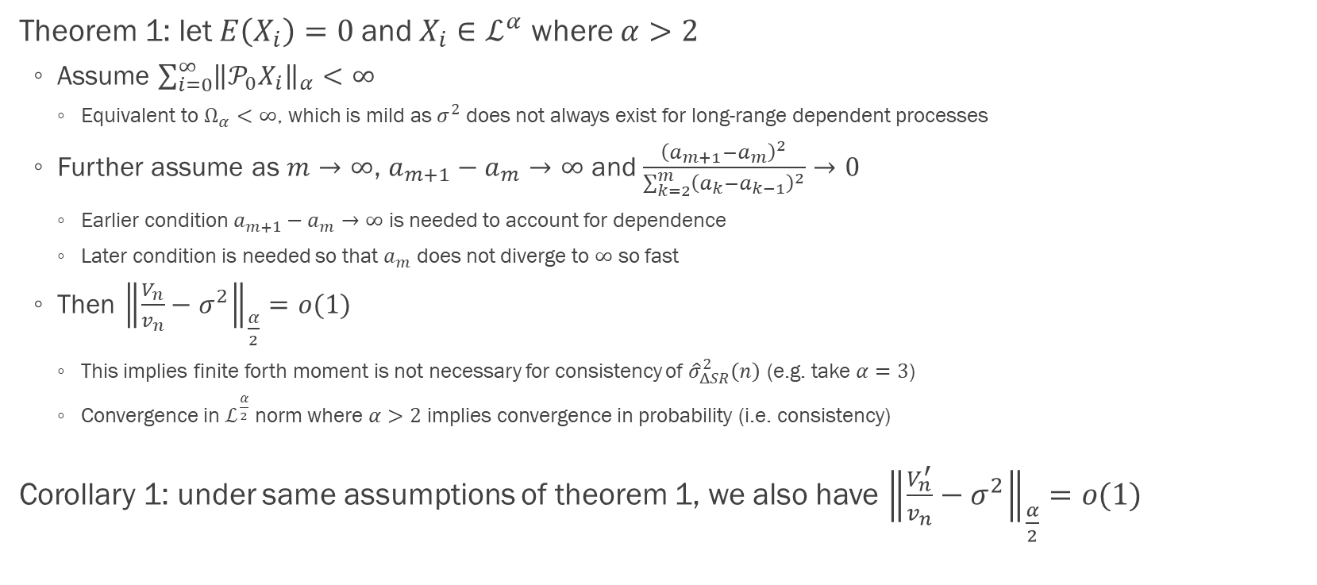
Moment convergence (p.6-7)
Theorem 1: let $E\left(X_{i}\right)=0$ and $X_{i}∈ℒ^{α}$ where $α>2$
Assume $\sum_{i=0}^{∞}{{\left\|𝒫_{0}X_{i}\right\|}_{α}}<∞$
Equivalent to $Ω_{α}<∞$, which is mild as $σ^{2}$ does not always exist for long-range dependent processes
Further assume as $m→∞$, $a_{m+1}−a_{m}→∞$ and $\frac{{\left(a_{m+1}−a_{m}\right)}^{2}}{\sum_{k=2}^{m}{{\left(a_{k}−a_{k−1}\right)}^{2}}}→0$
Earlier condition $a_{m+1}−a_{m}→∞$ is needed to account for dependence
Later condition is needed so that $a_{m}$ does not diverge to $∞$ so fast
Then ${\left\|\frac{V_{n}}{v_{n}}−σ^{2}\right\|}_{\frac{α}{2}}=o(1)$
This implies finite forth moment is not necessary for consistency of ${\hat{σ}}_{ΔSR}^{2}\left(n\right)$ (e.g. take $α=3$)
Convergence in $ℒ^{\frac{α}{2}}$ norm where $α>2$ implies convergence in probability (i.e. consistency)
Corollary 1: under same assumptions of theorem 1, we also have ${\left\|\frac{V_{n}^{′}}{v_{n}}−σ^{2}\right\|}_{\frac{α}{2}}=o(1)$

Slide 15
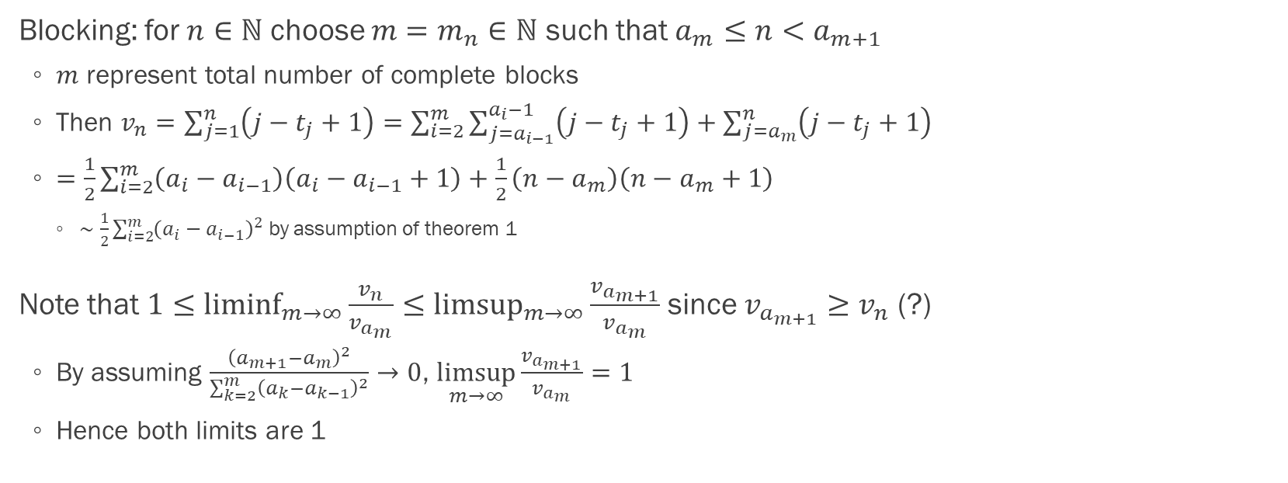
Proof of theorem 1: blocking (p.13)
Blocking: for $n∈ℕ$ choose $m=m_{n}∈ℕ$ such that $a_{m}≤n<a_{m+1}$
$m$ represent total number of complete blocks
Then $v_{n}=\sum_{j=1}^{n}{\left(j−t_{j}+1\right)}=\sum_{i=2}^{m}{\sum_{j=a_{i−1}}^{a_{i}−1}{\left(j−t_{j}+1\right)}}+\sum_{j=a_{m}}^{n}{\left(j−t_{j}+1\right)}$
$=\frac{1}{2}\sum_{i=2}^{m}{\left(a_{i}−a_{i−1}\right)\left(a_{i}−a_{i−1}+1\right)}+\frac{1}{2}\left(n−a_{m}\right)\left(n−a_{m}+1\right)$
$∼\frac{1}{2}\sum_{i=2}^{m}{{\left(a_{i}−a_{i−1}\right)}^{2}}$ by assumption of theorem 1
Note that $1≤\underset{m→∞}{liminf}{\frac{v_{n}}{v_{a_{m}}}}≤\underset{m→∞}{limsup}{\frac{v_{a_{m+1}}}{v_{a_{m}}}}$ since $v_{a_{m+1}}≥v_{n}$ (?)
By assuming $\frac{{\left(a_{m+1}−a_{m}\right)}^{2}}{\sum_{k=2}^{m}{{\left(a_{k}−a_{k−1}\right)}^{2}}}→0$, $\underset{m→∞}{limsup}{\frac{v_{a_{m+1}}}{v_{a_{m}}}}=1$
Hence both limits are 1

Slide 16
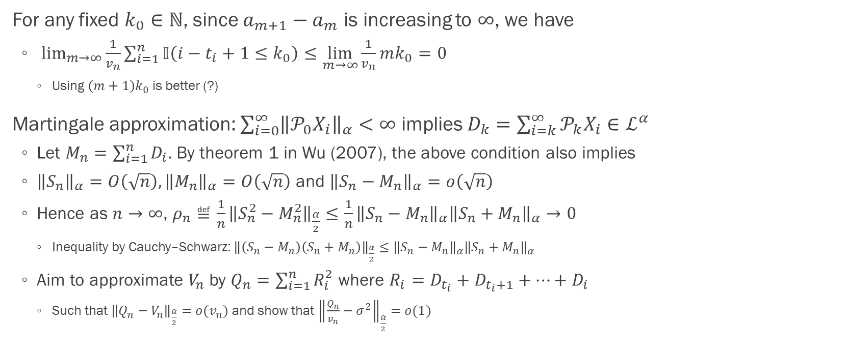
Proof of theorem 1: martingale approximation (p.13)
For any fixed $k_{0}∈ℕ$, since $a_{m+1}−a_{m}$ is increasing to $∞$, we have
$\lim_{m→∞}{\frac{1}{v_{n}}\sum_{i=1}^{n}{𝕀\left(i−t_{i}+1≤k_{0}\right)}}≤\lim_{m→∞}{\frac{1}{v_{n}}mk_{0}}=0$
Using $\left(m+1\right)k_{0}$ is better (?)
Martingale approximation: $\sum_{i=0}^{∞}{{\left\|𝒫_{0}X_{i}\right\|}_{α}}<∞$ implies $D_{k}=\sum_{i=k}^{∞}{𝒫_{k}X_{i}}∈ℒ^{α}$
Let $M_{n}=\sum_{i=1}^{n}{D_{i}}$. By theorem 1 in Wu (2007), the above condition also implies
${\left\|S_{n}\right\|}_{α}=O\left(\sqrt{n}\right),{\left\|M_{n}\right\|}_{α}=O\left(\sqrt{n}\right)$ and ${\left\|S_{n}−M_{n}\right\|}_{α}=o\left(\sqrt{n}\right)$
Hence as $n→∞$, $ρ_{n}≝\frac{1}{n}{\left\|S_{n}^{2}−M_{n}^{2}\right\|}_{\frac{α}{2}}≤\frac{1}{n}{\left\|S_{n}−M_{n}\right\|}_{α}{\left\|S_{n}+M_{n}\right\|}_{α}→0$
Inequality by Cauchy–Schwarz: ${\left\|\left(S_{n}−M_{n}\right)\left(S_{n}+M_{n}\right)\right\|}_{\frac{α}{2}}≤{\left\|S_{n}−M_{n}\right\|}_{α}{\left\|S_{n}+M_{n}\right\|}_{α}$
Aim to approximate $V_{n}$ by $Q_{n}=\sum_{i=1}^{n}{R_{i}^{2}}$ where $R_{i}=D_{t_{i}}+D_{t_{i}+1}+…+D_{i}$
Such that ${\left\|Q_{n}−V_{n}\right\|}_{\frac{α}{2}}=o(v_{n})$ and show that ${\left\|\frac{Q_{n}}{v_{n}}−σ^{2}\right\|}_{\frac{α}{2}}=o(1)$

Slide 17
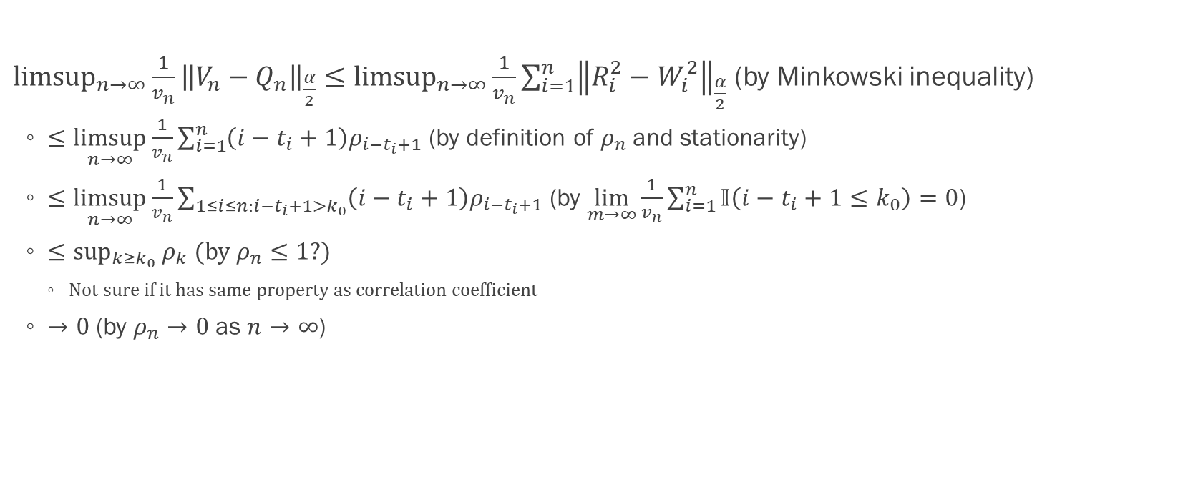
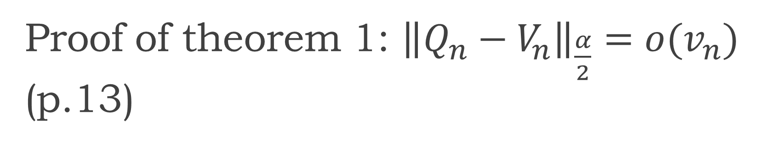
Proof of theorem 1: ${\left\|Q_{n}−V_{n}\right\|}_{\frac{α}{2}}=o(v_{n})$ (p.13)
$\underset{n→∞}{limsup}{\frac{1}{v_{n}}{\left\|V_{n}−Q_{n}\right\|}_{\frac{α}{2}}}≤\underset{n→∞}{limsup}{\frac{1}{v_{n}}\sum_{i=1}^{n}{{\left\|R_{i}^{2}−W_{i}^{2}\right\|}_{\frac{α}{2}}}}$ (by Minkowski inequality)
$≤\underset{n→∞}{limsup}{\frac{1}{v_{n}}\sum_{i=1}^{n}{\left(i−t_{i}+1\right)ρ_{i−t_{i}+1}}}$ (by definition of $ρ_{n}$ and stationarity)
$≤\underset{n→∞}{limsup}{\frac{1}{v_{n}}\sum_{1≤i≤n:i−t_{i}+1>k_{0}}{\left(i−t_{i}+1\right)ρ_{i−t_{i}+1}}}$ (by $\lim_{m→∞}{\frac{1}{v_{n}}\sum_{i=1}^{n}{𝕀\left(i−t_{i}+1≤k_{0}\right)}}=0$)
$≤\sup_{k≥k_{0}}{ρ_{k}}$ (by $ρ_{n}≤1$?)
Not sure if it has same property as correlation coefficient
$→0$ (by $ρ_{n}→0$ as $n→∞$)

Slide 18
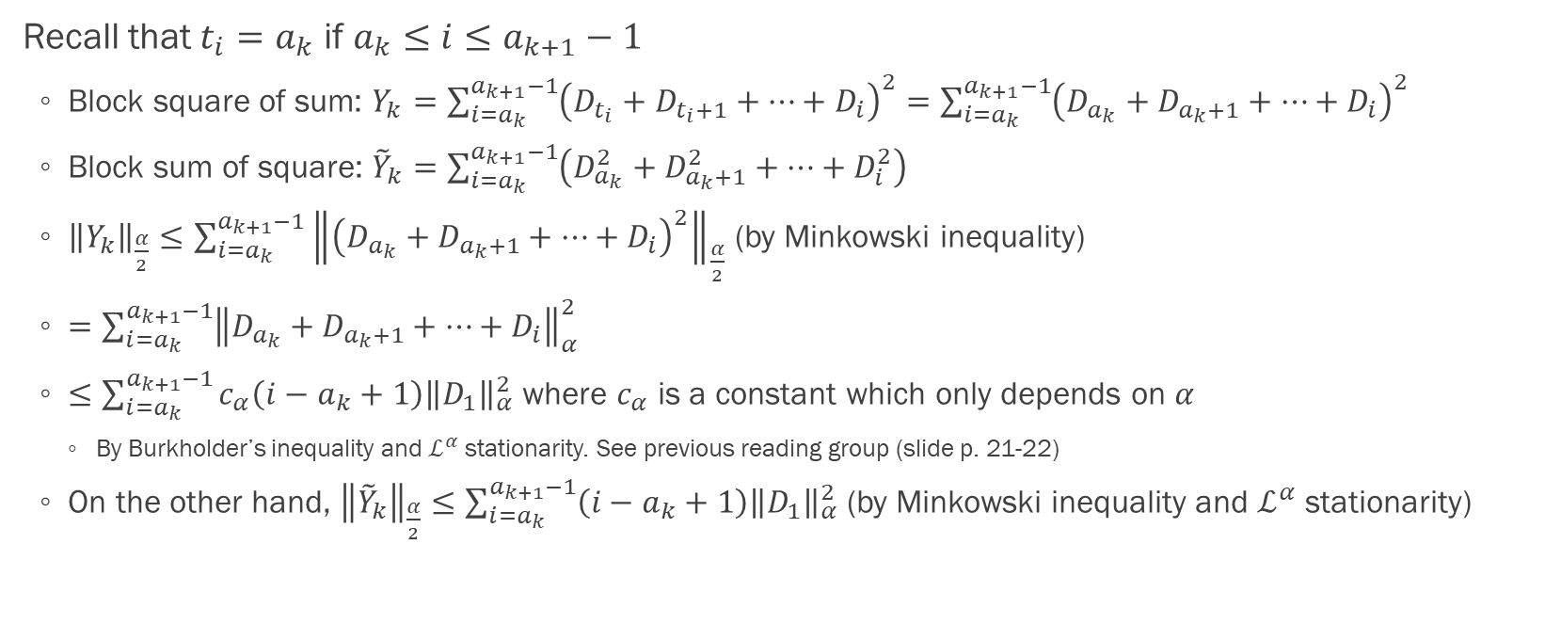

Proof of theorem 1: ${\left\|\frac{Q_{n}}{v_{n}}−σ^{2}\right\|}_{\frac{α}{2}}=o(1)$ (p.14)
Recall that $t_{i}=a_{k}$ if $a_{k}≤i≤a_{k+1}−1$
Block square of sum: $Y_{k}=\sum_{i=a_{k}}^{a_{k+1}−1}{{\left(D_{t_{i}}+D_{t_{i}+1}+…+D_{i}\right)}^{2}}=\sum_{i=a_{k}}^{a_{k+1}−1}{{\left(D_{a_{k}}+D_{a_{k}+1}+…+D_{i}\right)}^{2}}$
Block sum of square: ${\tilde{Y}}_{k}=\sum_{i=a_{k}}^{a_{k+1}−1}{\left(D_{a_{k}}^{2}+D_{a_{k}+1}^{2}+…+D_{i}^{2}\right)}$
${\left\|Y_{k}\right\|}_{\frac{α}{2}}≤\sum_{i=a_{k}}^{a_{k+1}−1}{{\left\|{\left(D_{a_{k}}+D_{a_{k}+1}+…+D_{i}\right)}^{2}\right\|}_{\frac{α}{2}}}$ (by Minkowski inequality)
$=\sum_{i=a_{k}}^{a_{k+1}−1}{{\left\|D_{a_{k}}+D_{a_{k}+1}+…+D_{i}\right\|}_{α}^{2}}$
$≤\sum_{i=a_{k}}^{a_{k+1}−1}{c_{α}\left(i−a_{k}+1\right){\left\|D_{1}\right\|}_{α}^{2}}$ where $c_{α}$ is a constant which only depends on $α$
By Burkholder’s inequality and $ℒ^{α}$ stationarity. See previous reading group (slide p. 21-22)
On the other hand, ${\left\|{\tilde{Y}}_{k}\right\|}_{\frac{α}{2}}≤\sum_{i=a_{k}}^{a_{k+1}−1}{\left(i−a_{k}+1\right){\left\|D_{1}\right\|}_{α}^{2}}$ (by Minkowski inequality and $ℒ^{α}$ stationarity)

Slide 19
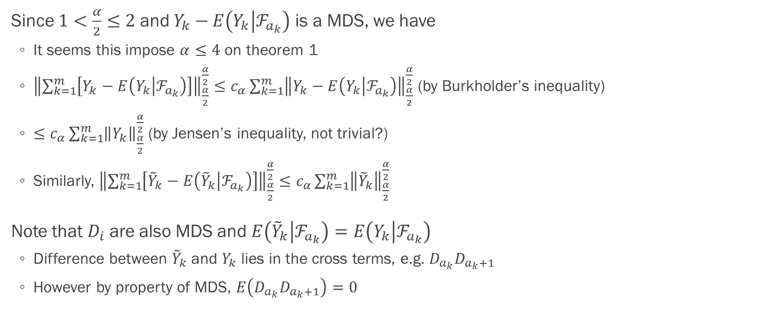
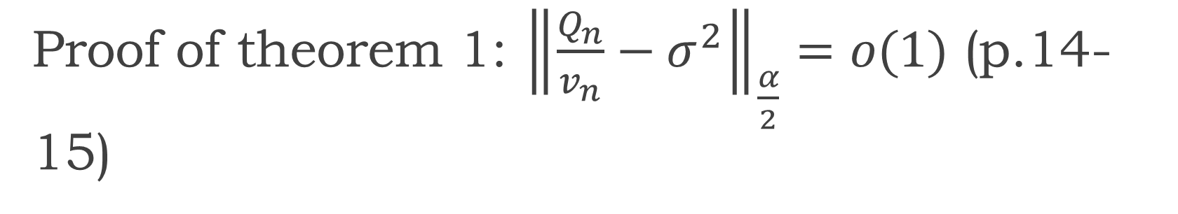
Proof of theorem 1: ${\left\|\frac{Q_{n}}{v_{n}}−σ^{2}\right\|}_{\frac{α}{2}}=o(1)$ (p.14-15)
Since $1<\frac{α}{2}≤2$ and $Y_{k}−E\left(Y_{k} | ℱ_{a_{k}}\right)$ is a MDS, we have
It seems this impose $α≤4$ on theorem 1
${\left\|\sum_{k=1}^{m}{\left[Y_{k}−E\left(Y_{k} | ℱ_{a_{k}}\right)\right]}\right\|}_{\frac{α}{2}}^{\frac{α}{2}}≤c_{α}\sum_{k=1}^{m}{{\left\|Y_{k}−E\left(Y_{k} | ℱ_{a_{k}}\right)\right\|}_{\frac{α}{2}}^{\frac{α}{2}}}$ (by Burkholder’s inequality)
$≤c_{α}\sum_{k=1}^{m}{{\left\|Y_{k}\right\|}_{\frac{α}{2}}^{\frac{α}{2}}}$ (by Jensen’s inequality, not trivial?)
Similarly, ${\left\|\sum_{k=1}^{m}{\left[{\tilde{Y}}_{k}−E\left({\tilde{Y}}_{k} | ℱ_{a_{k}}\right)\right]}\right\|}_{\frac{α}{2}}^{\frac{α}{2}}≤c_{α}\sum_{k=1}^{m}{{\left\|{\tilde{Y}}_{k}\right\|}_{\frac{α}{2}}^{\frac{α}{2}}}$
Note that $D_{i}$ are also MDS and $E\left({\tilde{Y}}_{k} | ℱ_{a_{k}}\right)=E\left(Y_{k} | ℱ_{a_{k}}\right)$
Difference between ${\tilde{Y}}_{k}$ and $Y_{k}$ lies in the cross terms, e.g. $D_{a_{k}}D_{a_{k}+1}$
However by property of MDS, $E\left(D_{a_{k}}D_{a_{k}+1}\right)=0$

Slide 20
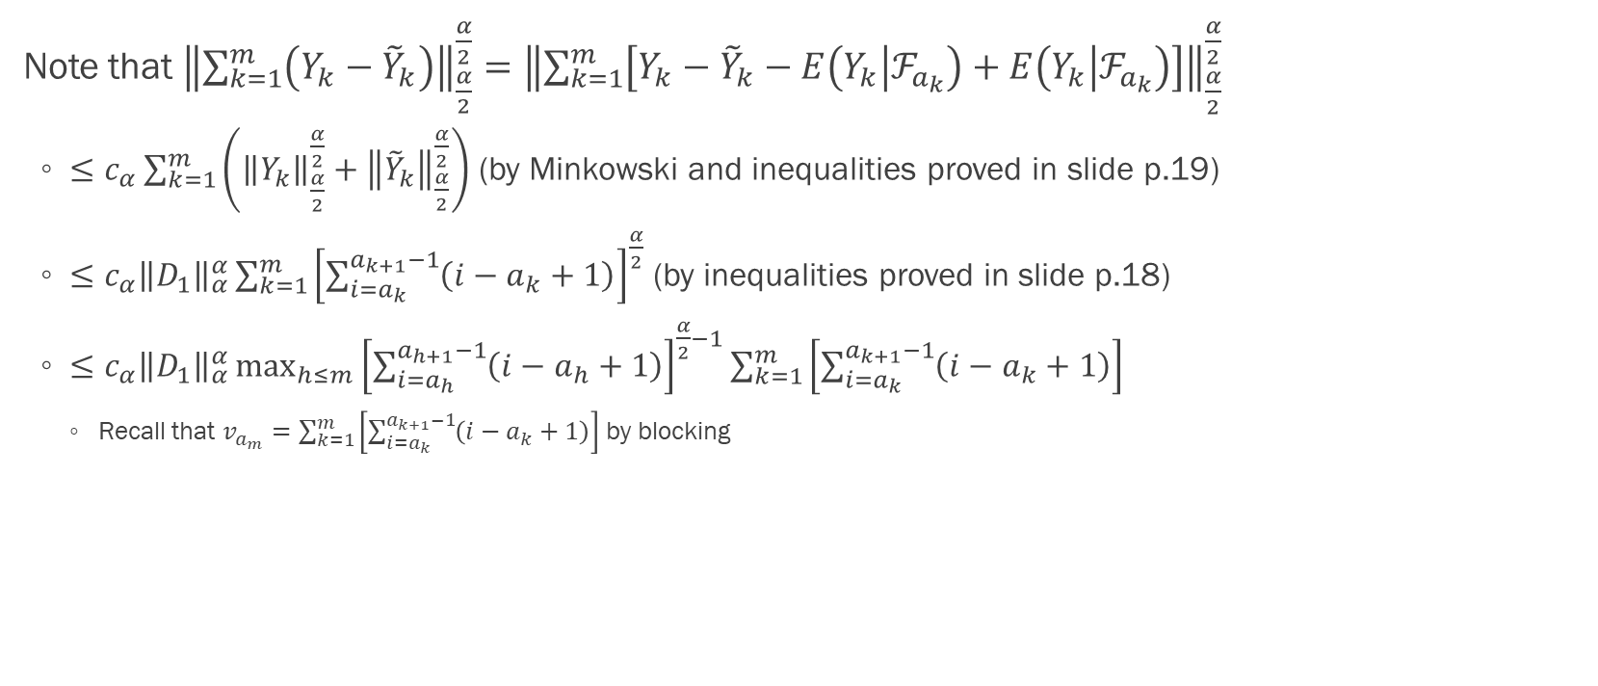

Proof of theorem 1: ${\left\|\frac{Q_{n}}{v_{n}}−σ^{2}\right\|}_{\frac{α}{2}}=o(1)$ (p.15)
Note that ${\left\|\sum_{k=1}^{m}{\left(Y_{k}−{\tilde{Y}}_{k}\right)}\right\|}_{\frac{α}{2}}^{\frac{α}{2}}={\left\|\sum_{k=1}^{m}{\left[Y_{k}−{\tilde{Y}}_{k}−E\left(Y_{k} | ℱ_{a_{k}}\right)+E\left(Y_{k} | ℱ_{a_{k}}\right)\right]}\right\|}_{\frac{α}{2}}^{\frac{α}{2}}$
$≤$ $c_{α}\sum_{k=1}^{m}{\left({\left\|Y_{k}\right\|}_{\frac{α}{2}}^{\frac{α}{2}}+{\left\|{\tilde{Y}}_{k}\right\|}_{\frac{α}{2}}^{\frac{α}{2}}\right)}$ (by Minkowski and inequalities proved in slide p.19)
$≤c_{α}{\left\|D_{1}\right\|}_{α}^{α}\sum_{k=1}^{m}{{\left[\sum_{i=a_{k}}^{a_{k+1}−1}{\left(i−a_{k}+1\right)}\right]}^{\frac{α}{2}}}$ (by inequalities proved in slide p.18)
$≤c_{α}{\left\|D_{1}\right\|}_{α}^{α}\max_{h≤m}{{\left[\sum_{i=a_{h}}^{a_{h+1}−1}{\left(i−a_{h}+1\right)}\right]}^{\frac{α}{2}−1}}\sum_{k=1}^{m}{\left[\sum_{i=a_{k}}^{a_{k+1}−1}{\left(i−a_{k}+1\right)}\right]}$
Recall that $v_{a_{m}}=\sum_{k=1}^{m}{\left[\sum_{i=a_{k}}^{a_{k+1}−1}{\left(i−a_{k}+1\right)}\right]}$ by blocking

Slide 21
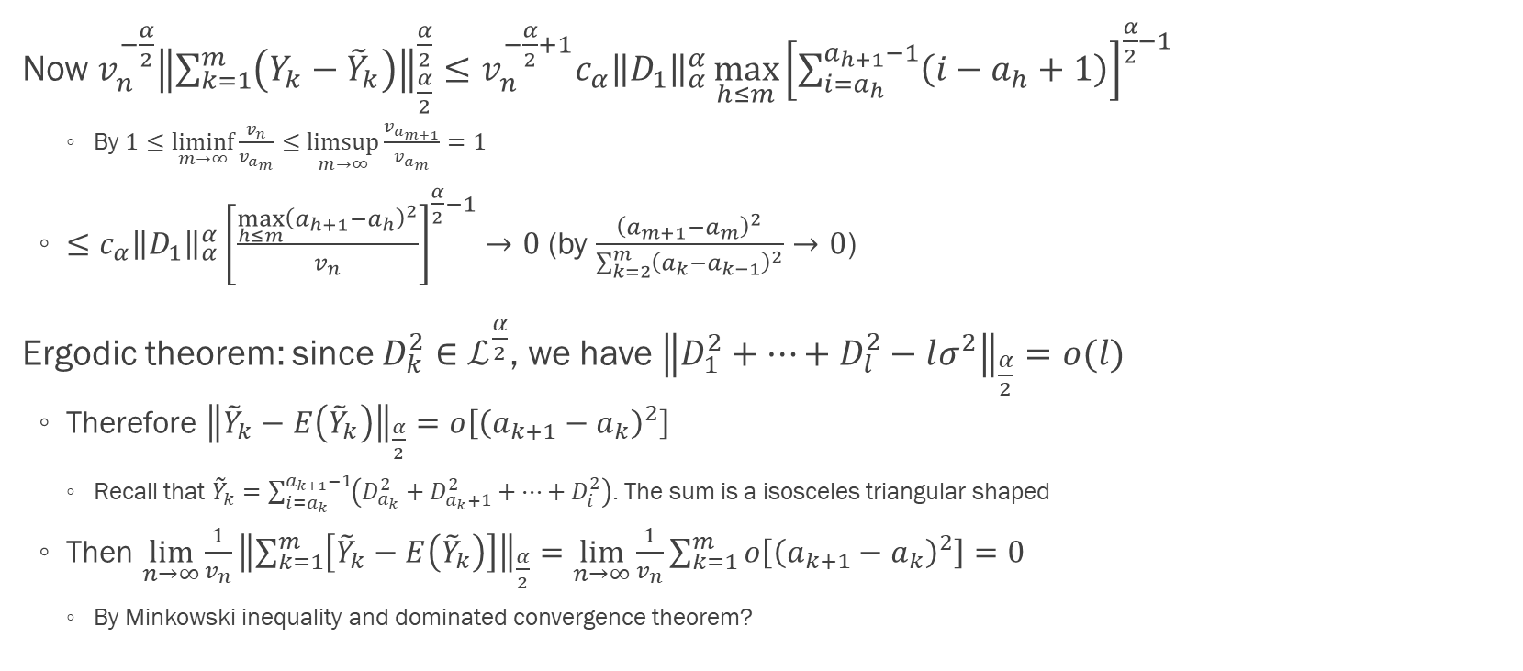
Proof of theorem 1: ${\left\|\frac{Q_{n}}{v_{n}}−σ^{2}\right\|}_{\frac{α}{2}}=o(1)$ (p.15)
Now $v_{n}^{−\frac{α}{2}}{\left\|\sum_{k=1}^{m}{\left(Y_{k}−{\tilde{Y}}_{k}\right)}\right\|}_{\frac{α}{2}}^{\frac{α}{2}}≤v_{n}^{−\frac{α}{2}+1}c_{α}{\left\|D_{1}\right\|}_{α}^{α}\max_{h≤m}{{\left[\sum_{i=a_{h}}^{a_{h+1}−1}{\left(i−a_{h}+1\right)}\right]}^{\frac{α}{2}−1}}$
By $1≤\underset{m→∞}{liminf}{\frac{v_{n}}{v_{a_{m}}}}≤\underset{m→∞}{limsup}{\frac{v_{a_{m+1}}}{v_{a_{m}}}}=1$
$≤c_{α}{\left\|D_{1}\right\|}_{α}^{α}{\left[\frac{\max_{h≤m}{{\left(a_{h+1}−a_{h}\right)}^{2}}}{v_{n}}\right]}^{\frac{α}{2}−1}→0$ (by $\frac{{\left(a_{m+1}−a_{m}\right)}^{2}}{\sum_{k=2}^{m}{{\left(a_{k}−a_{k−1}\right)}^{2}}}→0$)
Ergodic theorem: since $D_{k}^{2}∈ℒ^{\frac{α}{2}}$, we have ${\left\|D_{1}^{2}+…+D_{l}^{2}−lσ^{2}\right\|}_{\frac{α}{2}}=o(l)$
Therefore ${\left\|{\tilde{Y}}_{k}−E\left({\tilde{Y}}_{k}\right)\right\|}_{\frac{α}{2}}=o\left[{\left(a_{k+1}−a_{k}\right)}^{2}\right]$
Recall that ${\tilde{Y}}_{k}=\sum_{i=a_{k}}^{a_{k+1}−1}{\left(D_{a_{k}}^{2}+D_{a_{k}+1}^{2}+…+D_{i}^{2}\right)}$. The sum is a isosceles triangular shaped
Then $\lim_{n→∞}{\frac{1}{v_{n}}{\left\|\sum_{k=1}^{m}{\left[{\tilde{Y}}_{k}−E\left({\tilde{Y}}_{k}\right)\right]}\right\|}_{\frac{α}{2}}}=\lim_{n→∞}{\frac{1}{v_{n}}\sum_{k=1}^{m}{o\left[{\left(a_{k+1}−a_{k}\right)}^{2}\right]}}=0$
By Minkowski inequality and dominated convergence theorem?

Slide 22
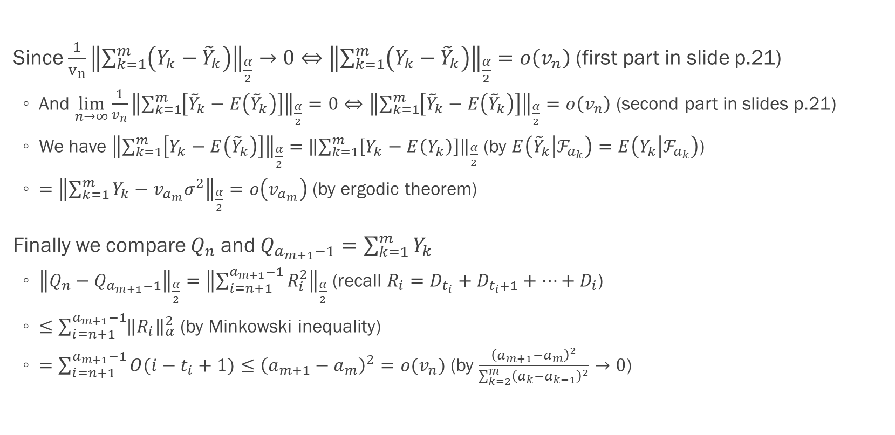
Proof of theorem 1: ${\left\|\frac{Q_{n}}{v_{n}}−σ^{2}\right\|}_{\frac{α}{2}}=o(1)$ (p.15)
Since $\frac{1}{v_{n}}{\left\|\sum_{k=1}^{m}{\left(Y_{k}−{\tilde{Y}}_{k}\right)}\right\|}_{\frac{α}{2}}→0⇔{\left\|\sum_{k=1}^{m}{\left(Y_{k}−{\tilde{Y}}_{k}\right)}\right\|}_{\frac{α}{2}}=o\left(v_{n}\right)$ (first part in slide p.21)
And $\lim_{n→∞}{\frac{1}{v_{n}}{\left\|\sum_{k=1}^{m}{\left[{\tilde{Y}}_{k}−E\left({\tilde{Y}}_{k}\right)\right]}\right\|}_{\frac{α}{2}}}=0⇔{\left\|\sum_{k=1}^{m}{\left[{\tilde{Y}}_{k}−E\left({\tilde{Y}}_{k}\right)\right]}\right\|}_{\frac{α}{2}}=o\left(v_{n}\right)$ (second part in slides p.21)
We have ${\left\|\sum_{k=1}^{m}{\left[Y_{k}−E\left({\tilde{Y}}_{k}\right)\right]}\right\|}_{\frac{α}{2}}=$ ${\left\|\sum_{k=1}^{m}{\left[Y_{k}−E\left(Y_{k}\right)\right]}\right\|}_{\frac{α}{2}}$ (by $E\left({\tilde{Y}}_{k} | ℱ_{a_{k}}\right)=E\left(Y_{k} | ℱ_{a_{k}}\right)$)
$={\left\|\sum_{k=1}^{m}{Y_{k}}−v_{a_{m}}σ^{2}\right\|}_{\frac{α}{2}}=o\left(v_{a_{m}}\right)$ (by ergodic theorem)
Finally we compare $Q_{n}$ and $Q_{a_{m+1}−1}=\sum_{k=1}^{m}{Y_{k}}$
${\left\|Q_{n}−Q_{a_{m+1}−1}\right\|}_{\frac{α}{2}}={\left\|\sum_{i=n+1}^{a_{m+1}−1}{R_{i}^{2}}\right\|}_{\frac{α}{2}}$ (recall $R_{i}=D_{t_{i}}+D_{t_{i}+1}+…+D_{i}$)
$≤\sum_{i=n+1}^{a_{m+1}−1}{{\left\|R_{i}\right\|}_{α}^{2}}$ (by Minkowski inequality)
$=\sum_{i=n+1}^{a_{m+1}−1}{O(i−t_{i}+1)}≤{\left(a_{m+1}−a_{m}\right)}^{2}=o(v_{n})$ (by $\frac{{\left(a_{m+1}−a_{m}\right)}^{2}}{\sum_{k=2}^{m}{{\left(a_{k}−a_{k−1}\right)}^{2}}}→0$)

Slide 23
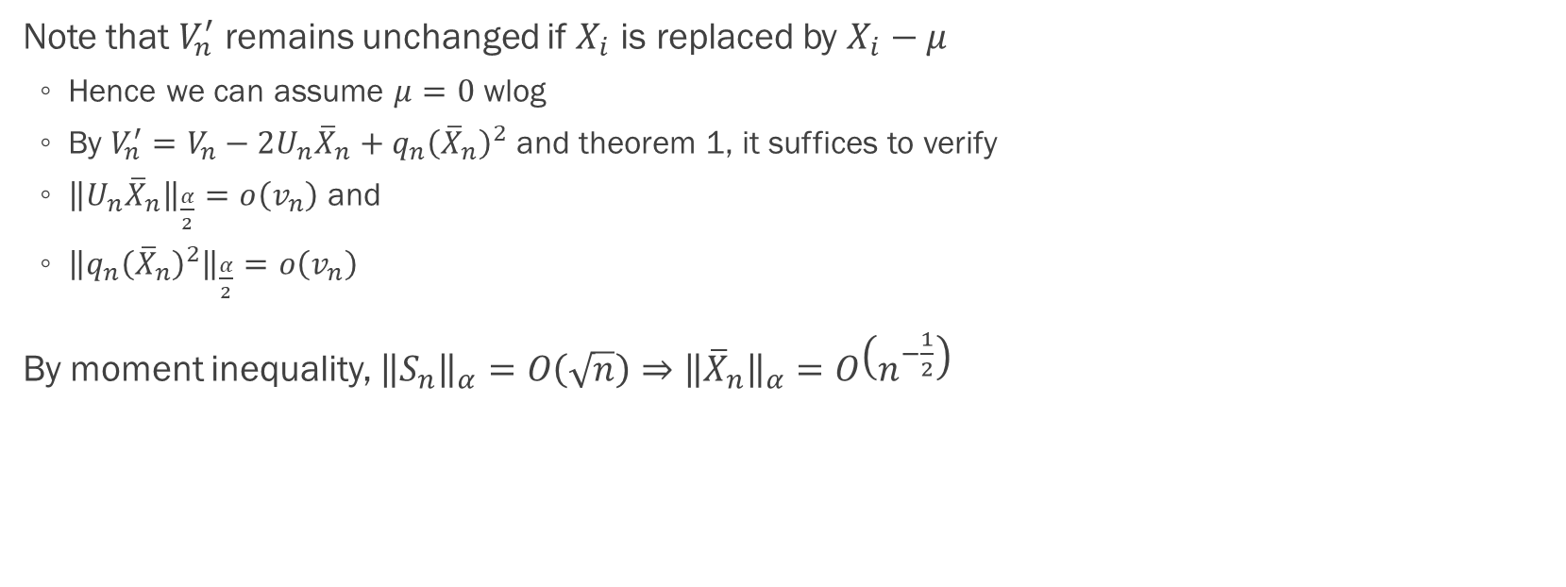
Proof of corollary 1: requirement (p.15)
Note that $V_{n}^{′}$ remains unchanged if $X_{i}$ is replaced by $X_{i}−μ$
Hence we can assume $μ=0$ wlog
By $V_{n}^{′}=V_{n}−2U_{n}{\overline{X}}_{n}+q_{n}{\left({\overline{X}}_{n}\right)}^{2}$ and theorem 1, it suffices to verify
${\left\|U_{n}{\overline{X}}_{n}\right\|}_{\frac{α}{2}}=o\left(v_{n}\right)$ and
${\left\|q_{n}{\left({\overline{X}}_{n}\right)}^{2}\right\|}_{\frac{α}{2}}=o\left(v_{n}\right)$
By moment inequality, ${\left\|S_{n}\right\|}_{α}=O\left(\sqrt{n}\right)⇒{\left\|{\overline{X}}_{n}\right\|}_{α}=O\left(n^{−\frac{1}{2}}\right)$

Slide 24
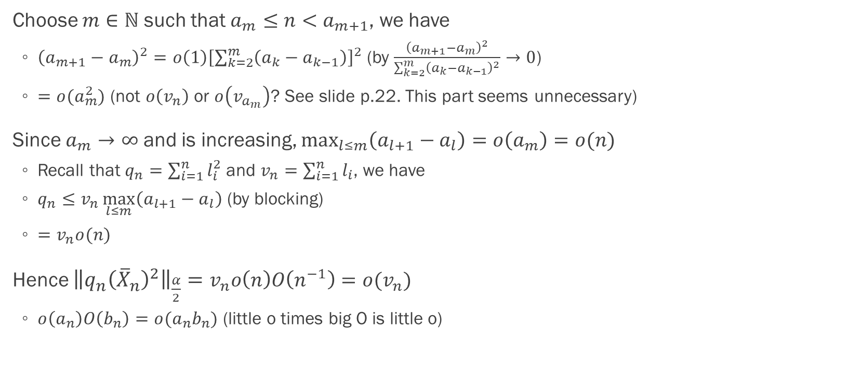
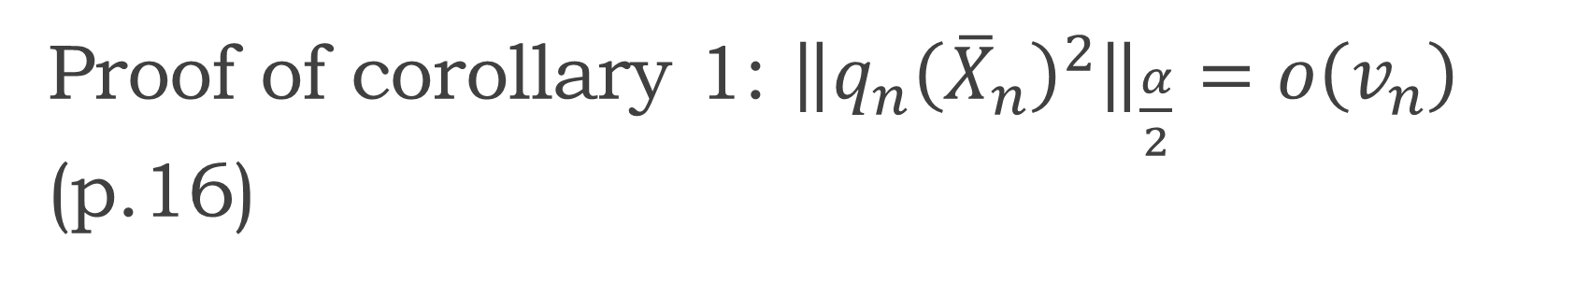
Proof of corollary 1: ${\left\|q_{n}{\left({\overline{X}}_{n}\right)}^{2}\right\|}_{\frac{α}{2}}=o\left(v_{n}\right)$ (p.16)
Choose $m∈ℕ$ such that $a_{m}≤n<a_{m+1}$, we have
${\left(a_{m+1}−a_{m}\right)}^{2}=o\left(1\right){\left[\sum_{k=2}^{m}{\left(a_{k}−a_{k−1}\right)}\right]}^{2}$ (by $\frac{{\left(a_{m+1}−a_{m}\right)}^{2}}{\sum_{k=2}^{m}{{\left(a_{k}−a_{k−1}\right)}^{2}}}→0$)
$=o(a_{m}^{2})$ (not $o\left(v_{n}\right)$ or $o\left(v_{a_{m}}\right)$? See slide p.22. This part seems unnecessary)
Since $a_{m}→∞$ and is increasing, $\max_{l≤m}\left(a_{l+1}−a_{l}\right)=o\left(a_{m}\right)=o(n)$
Recall that $q_{n}=\sum_{i=1}^{n}{l_{i}^{2}}$ and $v_{n}=\sum_{i=1}^{n}{l_{i}}$, we have
$q_{n}≤v_{n}\max_{l≤m}\left(a_{l+1}−a_{l}\right)$ (by blocking)
$=v_{n}o(n)$
Hence ${\left\|q_{n}{\left({\overline{X}}_{n}\right)}^{2}\right\|}_{\frac{α}{2}}=v_{n}o\left(n\right)O\left(n^{−1}\right)=o(v_{n})$
$o\left(a_{n}\right)O\left(b_{n}\right)=o(a_{n}b_{n})$ (little o times big O is little o)

Slide 25
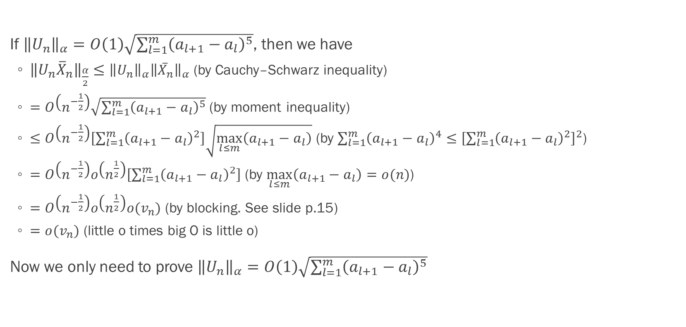
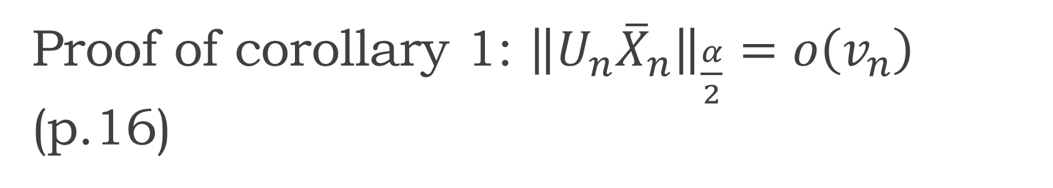
Proof of corollary 1: ${\left\|U_{n}{\overline{X}}_{n}\right\|}_{\frac{α}{2}}=o\left(v_{n}\right)$ (p.16)
If ${\left\|U_{n}\right\|}_{α}=O\left(1\right)\sqrt{\sum_{l=1}^{m}{{\left(a_{l+1}−a_{l}\right)}^{5}}}$, then we have
${\left\|U_{n}{\overline{X}}_{n}\right\|}_{\frac{α}{2}}≤{\left\|U_{n}\right\|}_{α}{\left\|{\overline{X}}_{n}\right\|}_{α}$ (by Cauchy–Schwarz inequality)
$=$ $O\left(n^{−\frac{1}{2}}\right)\sqrt{\sum_{l=1}^{m}{{\left(a_{l+1}−a_{l}\right)}^{5}}}$ (by moment inequality)
$≤O\left(n^{−\frac{1}{2}}\right)\left[\sum_{l=1}^{m}{{\left(a_{l+1}−a_{l}\right)}^{2}}\right]\sqrt{\max_{l≤m}\left(a_{l+1}−a_{l}\right)}$ (by $\sum_{l=1}^{m}{{\left(a_{l+1}−a_{l}\right)}^{4}}≤{\left[\sum_{l=1}^{m}{{\left(a_{l+1}−a_{l}\right)}^{2}}\right]}^{2}$)
$=O\left(n^{−\frac{1}{2}}\right)o\left(n^{\frac{1}{2}}\right)\left[\sum_{l=1}^{m}{{\left(a_{l+1}−a_{l}\right)}^{2}}\right]$ (by $\max_{l≤m}\left(a_{l+1}−a_{l}\right)=o(n)$)
$=O\left(n^{−\frac{1}{2}}\right)o\left(n^{\frac{1}{2}}\right)o(v_{n})$ (by blocking. See slide p.15)
$=o(v_{n})$ (little o times big O is little o)
Now we only need to prove ${\left\|U_{n}\right\|}_{α}=O\left(1\right)\sqrt{\sum_{l=1}^{m}{{\left(a_{l+1}−a_{l}\right)}^{5}}}$

Slide 26
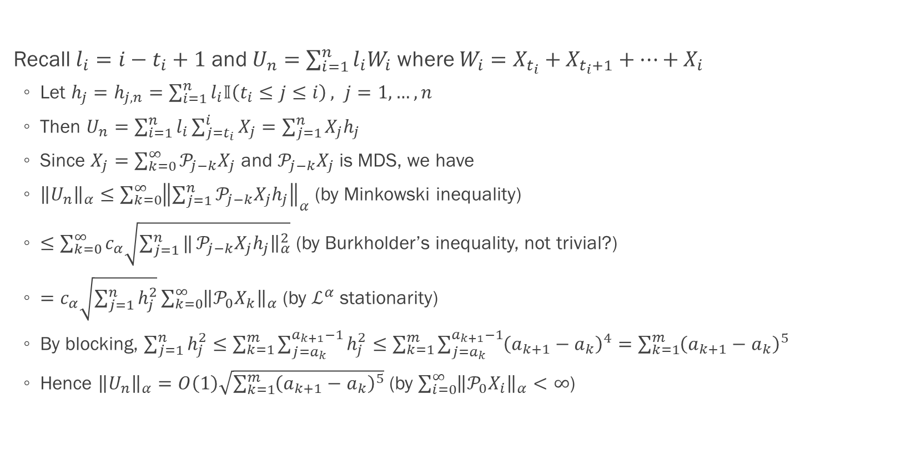
Proof of corollary 1: ${\left\|U_{n}{\overline{X}}_{n}\right\|}_{\frac{α}{2}}=o\left(v_{n}\right)$ (p.16)
Recall $l_{i}=i−t_{i}+1$ and $U_{n}=\sum_{i=1}^{n}{l_{i}W_{i}}$ where $W_{i}=X_{t_{i}}+X_{t_{i}+1}+…+X_{i}$
Let $h_{j}=h_{j,n}=\sum_{i=1}^{n}{l_{i}𝕀\left(t_{i}≤j≤i\right)}, j=1,…,n$
Then $U_{n}=\sum_{i=1}^{n}{l_{i}\sum_{j=t_{i}}^{i}{X_{j}}}=\sum_{j=1}^{n}{X_{j}h_{j}}$
Since $X_{j}=\sum_{k=0}^{∞}{𝒫_{j−k}X_{j}}$ and $𝒫_{j−k}X_{j}$ is MDS, we have
${\left\|U_{n}\right\|}_{α}≤\sum_{k=0}^{∞}{{\left\|\sum_{j=1}^{n}{𝒫_{j−k}X_{j}h_{j}}\right\|}_{α}}$ (by Minkowski inequality)
$≤\sum_{k=0}^{∞}{c_{α}\sqrt{\sum_{j=1}^{n}{‖}𝒫_{j−k}X_{j}h_{j}{\left.​\right\|}_{α}^{2}}}$ (by Burkholder’s inequality, not trivial?)
$=c_{α}\sqrt{\sum_{j=1}^{n}{h_{j}^{2}}}\sum_{k=0}^{∞}{{\left\|𝒫_{0}X_{k}\right\|}_{α}}$ (by $ℒ^{α}$ stationarity)
By blocking, $\sum_{j=1}^{n}{h_{j}^{2}}≤\sum_{k=1}^{m}{\sum_{j=a_{k}}^{a_{k+1}−1}{h_{j}^{2}}}≤\sum_{k=1}^{m}{\sum_{j=a_{k}}^{a_{k+1}−1}{{\left(a_{k+1}−a_{k}\right)}^{4}}}=\sum_{k=1}^{m}{{\left(a_{k+1}−a_{k}\right)}^{5}}$
Hence ${\left\|U_{n}\right\|}_{α}=O\left(1\right)\sqrt{\sum_{k=1}^{m}{{\left(a_{k+1}−a_{k}\right)}^{5}}}$ (by $\sum_{i=0}^{∞}{{\left\|𝒫_{0}X_{i}\right\|}_{α}}<∞$)

Slide 27
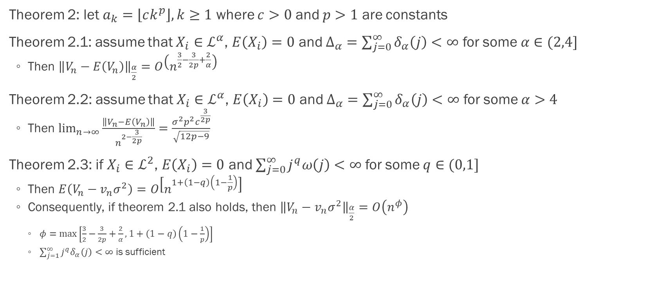
Convergence rate (p.8)
Theorem 2: let $a_{k}=\left\lfloor ck^{p}\right\rfloor , k≥1$ where $c>0$ and $p>1$ are constants
Theorem 2.1: assume that $X_{i}∈ℒ^{α}$, $E\left(X_{i}\right)=0$ and $Δ_{α}=\sum_{j=0}^{∞}{δ_{α}\left(j\right)}<∞$ for some $α∈(2,4]$
Then ${\left\|V_{n}−E\left(V_{n}\right)\right\|}_{\frac{α}{2}}=O\left(n^{\frac{3}{2}−\frac{3}{2p}+\frac{2}{α}}\right)$
Theorem 2.2: assume that $X_{i}∈ℒ^{α}$, $E\left(X_{i}\right)=0$ and $Δ_{α}=\sum_{j=0}^{∞}{δ_{α}\left(j\right)}<∞$ for some $α>4$
Then $\lim_{n→∞}{\frac{\left\|V_{n}−E\left(V_{n}\right)\right\|}{n^{2−\frac{3}{2p}}}}=\frac{σ^{2}p^{2}c^{\frac{3}{2p}}}{\sqrt{12p−9}}$
Theorem 2.3: if $X_{i}∈ℒ^{2}$, $E\left(X_{i}\right)=0$ and $\sum_{j=0}^{∞}{j^{q}ω\left(j\right)}<∞$ for some $q∈(0,1]$
Then $E\left(V_{n}−v_{n}σ^{2}\right)=O\left[n^{1+\left(1−q\right)\left(1−\frac{1}{p}\right)}\right]$
Consequently, if theorem 2.1 also holds, then ${\left\|V_{n}−v_{n}σ^{2}\right\|}_{\frac{α}{2}}=O\left(n^{φ}\right)$
$φ=\max\left[\frac{3}{2}−\frac{3}{2p}+\frac{2}{α}, 1+\left(1−q\right)\left(1−\frac{1}{p}\right)\right]$
$\sum_{j=1}^{∞}{j^{q}δ_{α}\left(j\right)}<∞$ is sufficient

Slide 28
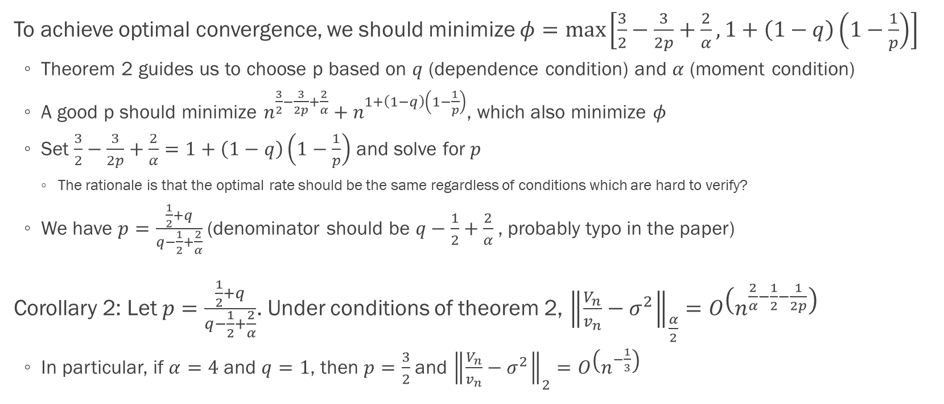
Optimal convergence rate (p.8)
To achieve optimal convergence, we should minimize $φ=\max\left[\frac{3}{2}−\frac{3}{2p}+\frac{2}{α}, 1+\left(1−q\right)\left(1−\frac{1}{p}\right)\right]$
Theorem 2 guides us to choose p based on $q$ (dependence condition) and $α$ (moment condition)
A good p should minimize $n^{\frac{3}{2}−\frac{3}{2p}+\frac{2}{α}}+n^{1+\left(1−q\right)\left(1−\frac{1}{p}\right)}$, which also minimize $φ$
Set $\frac{3}{2}−\frac{3}{2p}+\frac{2}{α}=1+\left(1−q\right)\left(1−\frac{1}{p}\right)$ and solve for $p$
The rationale is that the optimal rate should be the same regardless of conditions which are hard to verify?
We have $p=\frac{\frac{1}{2}+q}{q−\frac{1}{2}+\frac{2}{α}}$ (denominator should be $q−\frac{1}{2}+\frac{2}{α}$, probably typo in the paper)
Corollary 2: Let $p=\frac{\frac{1}{2}+q}{q−\frac{1}{2}+\frac{2}{α}}$. Under conditions of theorem 2, ${\left\|\frac{V_{n}}{v_{n}}−σ^{2}\right\|}_{\frac{α}{2}}=O\left(n^{\frac{2}{α}−\frac{1}{2}−\frac{1}{2p}}\right)$
In particular, if $α=4$ and $q=1$, then $p=\frac{3}{2}$ and ${\left\|\frac{V_{n}}{v_{n}}−σ^{2}\right\|}_{2}=O\left(n^{−\frac{1}{3}}\right)$

Slide 29
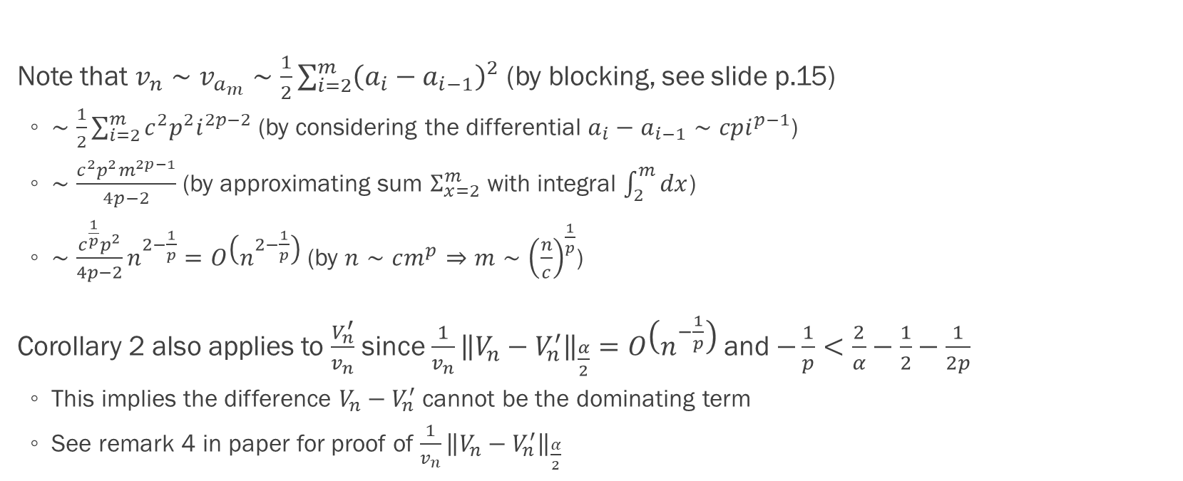
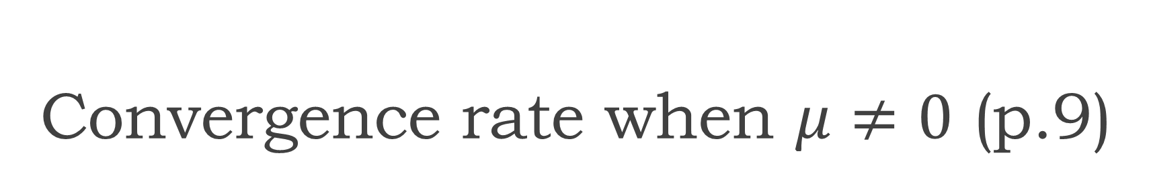
Convergence rate when $μ≠0$ (p.9)
Note that $v_{n}∼v_{a_{m}}∼\frac{1}{2}\sum_{i=2}^{m}{{\left(a_{i}−a_{i−1}\right)}^{2}}$ (by blocking, see slide p.15)
$∼\frac{1}{2}\sum_{i=2}^{m}{c^{2}p^{2}i^{2p−2}}$ (by considering the differential $a_{i}−a_{i−1}∼cpi^{p−1}$)
$∼\frac{c^{2}p^{2}m^{2p−1}}{4p−2}$ (by approximating sum $Σ_{x=2}^{m}$ with integral $\int_{2}^{m}{dx}$)
$∼\frac{c^{\frac{1}{p}}p^{2}}{4p−2}n^{2−\frac{1}{p}}=O\left(n^{2−\frac{1}{p}}\right)$ (by $n∼cm^{p}⇒m∼{\left(\frac{n}{c}\right)}^{\frac{1}{p}}$)
Corollary 2 also applies to $\frac{V_{n}^{′}}{v_{n}}$ since $\frac{1}{v_{n}}{\left\|V_{n}−V_{n}^{′}\right\|}_{\frac{α}{2}}=O\left(n^{−\frac{1}{p}}\right)$ and $−\frac{1}{p}<\frac{2}{α}−\frac{1}{2}−\frac{1}{2p}$
This implies the difference $V_{n}−V_{n}^{′}$ cannot be the dominating term
See remark 4 in paper for proof of $\frac{1}{v_{n}}{\left\|V_{n}−V_{n}^{′}\right\|}_{\frac{α}{2}}$

Slide 30
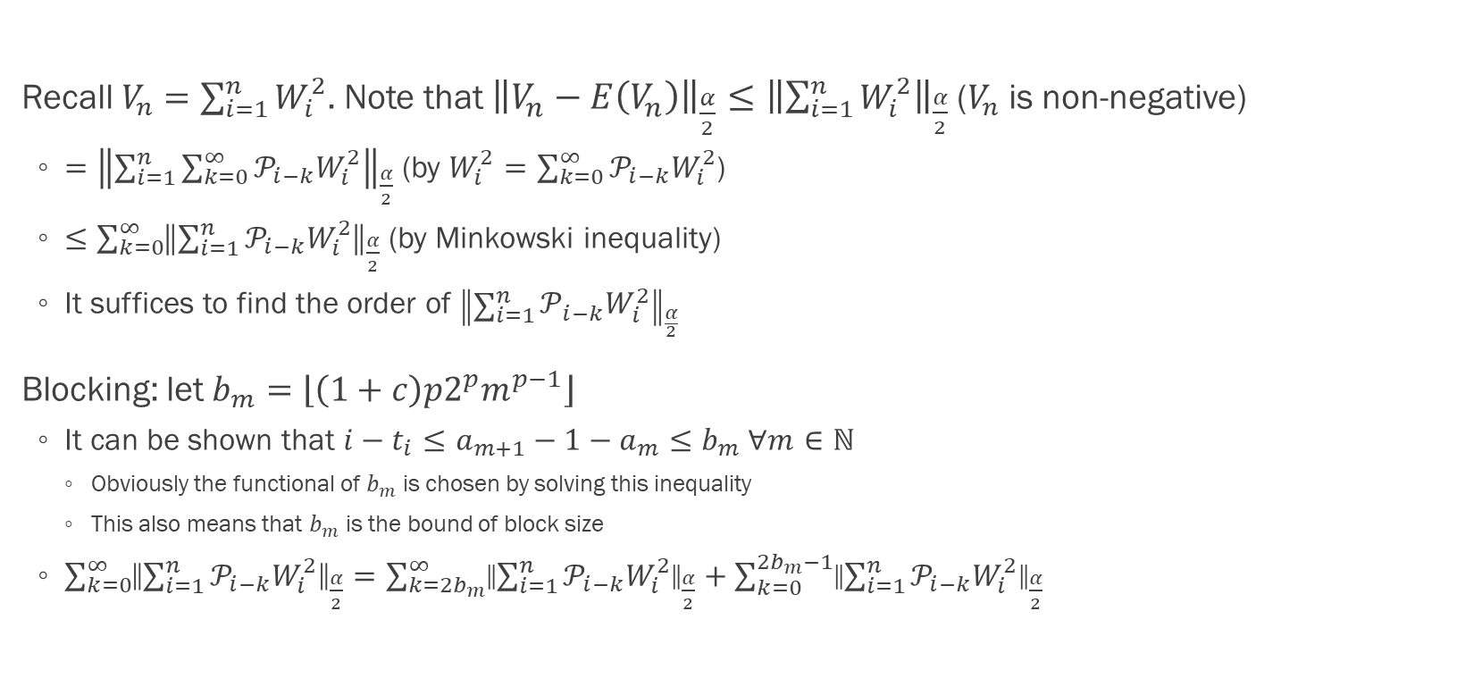
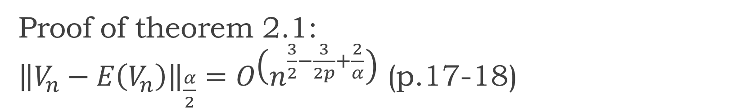
Proof of theorem 2.1: ${\left\|V_{n}−E\left(V_{n}\right)\right\|}_{\frac{α}{2}}=O\left(n^{\frac{3}{2}−\frac{3}{2p}+\frac{2}{α}}\right)$ (p.17-18)
Recall $V_{n}=\sum_{i=1}^{n}{W_{i}^{2}}$. Note that ${\left\|V_{n}−E\left(V_{n}\right)\right\|}_{\frac{α}{2}}≤{\left\|\sum_{i=1}^{n}{W_{i}^{2}}\right\|}_{\frac{α}{2}}$ ($V_{n}$ is non-negative)
$={\left\|\sum_{i=1}^{n}{\sum_{k=0}^{∞}{𝒫_{i−k}W_{i}^{2}}}\right\|}_{\frac{α}{2}}$ (by $W_{i}^{2}=\sum_{k=0}^{∞}{𝒫_{i−k}W_{i}^{2}}$)
$≤\sum_{k=0}^{∞}{{\left\|\sum_{i=1}^{n}{𝒫_{i−k}W_{i}^{2}}\right\|}_{\frac{α}{2}}}$ (by Minkowski inequality)
It suffices to find the order of ${\left\|\sum_{i=1}^{n}{𝒫_{i−k}W_{i}^{2}}\right\|}_{\frac{α}{2}}$
Blocking: let $b_{m}=\left\lfloor \left(1+c\right)p2^{p}m^{p−1}\right\rfloor$
It can be shown that $i−t_{i}≤a_{m+1}−1−a_{m}≤b_{m} ∀m∈ℕ$
Obviously the functional of $b_{m}$ is chosen by solving this inequality
This also means that $b_{m}$ is the bound of block size
$\sum_{k=0}^{∞}{{\left\|\sum_{i=1}^{n}{𝒫_{i−k}W_{i}^{2}}\right\|}_{\frac{α}{2}}}=\sum_{k=2b_{m}}^{∞}{{\left\|\sum_{i=1}^{n}{𝒫_{i−k}W_{i}^{2}}\right\|}_{\frac{α}{2}}}+\sum_{k=0}^{2b_{m}−1}{{\left\|\sum_{i=1}^{n}{𝒫_{i−k}W_{i}^{2}}\right\|}_{\frac{α}{2}}}$

Slide 31
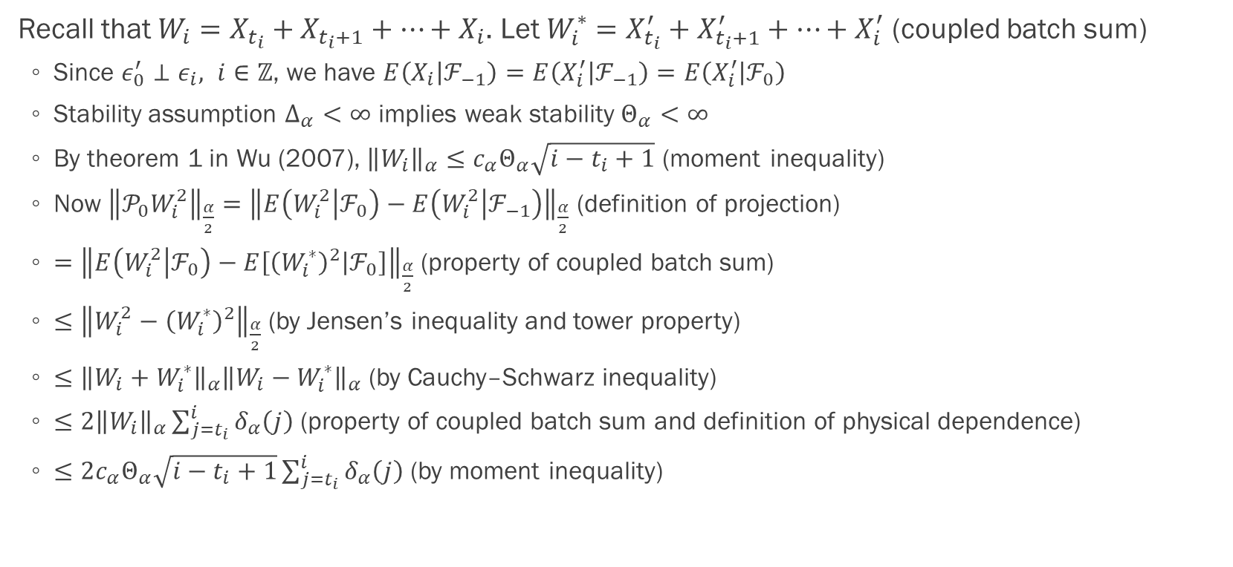
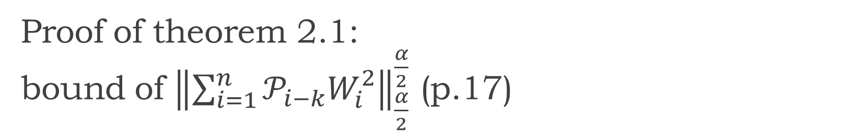
Proof of theorem 2.1: bound of ${\left\|\sum_{i=1}^{n}{𝒫_{i−k}W_{i}^{2}}\right\|}_{\frac{α}{2}}^{\frac{α}{2}}$ (p.17)
Recall that $W_{i}=X_{t_{i}}+X_{t_{i}+1}+…+X_{i}$. Let $W_{i}^{∗}=X_{t_{i}}^{′}+X_{t_{i}+1}^{′}+…+X_{i}^{′}$ (coupled batch sum)
Since $ε_{0}^{′}⊥ε_{i}, i∈ℤ$, we have $E\left(X_{i} | ℱ_{−1}\right)=E\left(X_{i}^{′} | ℱ_{−1}\right)=E\left(X_{i}^{′} | ℱ_{0}\right)$
Stability assumption $Δ_{α}<∞$ implies weak stability $Θ_{α}<∞$
By theorem 1 in Wu (2007), ${\left\|W_{i}\right\|}_{α}≤c_{α}Θ_{α}\sqrt{i−t_{i}+1}$ (moment inequality)
Now ${\left\|𝒫_{0}W_{i}^{2}\right\|}_{\frac{α}{2}}={\left\|E\left(W_{i}^{2} | ℱ_{0}\right)−E\left(W_{i}^{2} | ℱ_{−1}\right)\right\|}_{\frac{α}{2}}$ (definition of projection)
$={\left\|E\left(W_{i}^{2} | ℱ_{0}\right)−E\left[{\left(W_{i}^{∗}\right)}^{2} | ℱ_{0}\right]\right\|}_{\frac{α}{2}}$ (property of coupled batch sum)
$≤{\left\|W_{i}^{2}−{\left(W_{i}^{∗}\right)}^{2}\right\|}_{\frac{α}{2}}$ (by Jensen’s inequality and tower property)
$≤{\left\|W_{i}+W_{i}^{∗}\right\|}_{α}{\left\|W_{i}−W_{i}^{∗}\right\|}_{α}$ (by Cauchy–Schwarz inequality)
$≤2{\left\|W_{i}\right\|}_{α}\sum_{j=t_{i}}^{i}{δ_{α}\left(j\right)}$ (property of coupled batch sum and definition of physical dependence)
$≤2c_{α}Θ_{α}\sqrt{i−t_{i}+1}\sum_{j=t_{i}}^{i}{δ_{α}\left(j\right)}$ (by moment inequality)

Slide 32
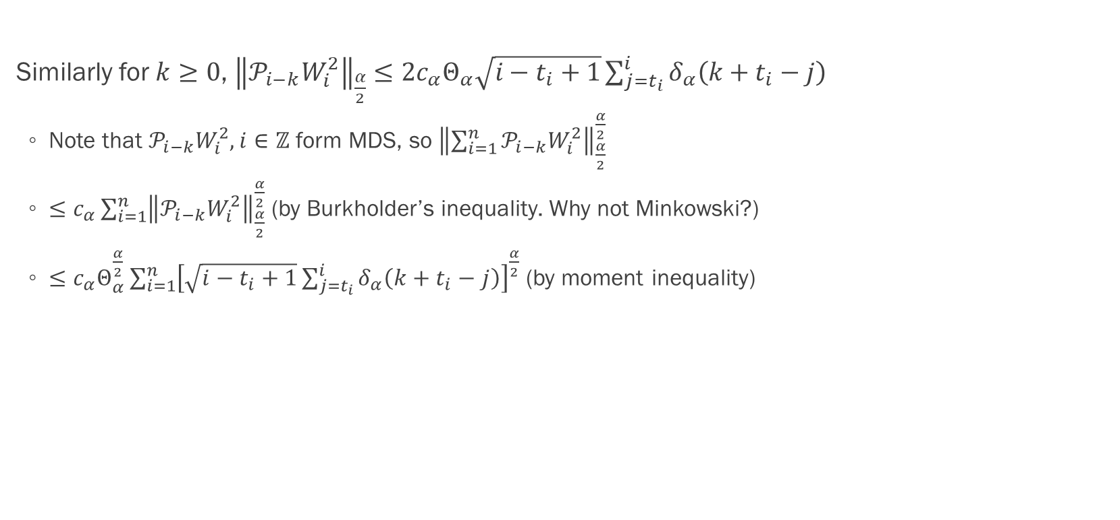
Proof of theorem 2.1: bound of ${\left\|\sum_{i=1}^{n}{𝒫_{i−k}W_{i}^{2}}\right\|}_{\frac{α}{2}}^{\frac{α}{2}}$ (p.17)
Similarly for $k≥0$, ${\left\|𝒫_{i−k}W_{i}^{2}\right\|}_{\frac{α}{2}}≤2c_{α}Θ_{α}\sqrt{i−t_{i}+1}\sum_{j=t_{i}}^{i}{δ_{α}\left(k+t_{i}−j\right)}$
Note that $𝒫_{i−k}W_{i}^{2}, i∈ℤ$ form MDS, so ${\left\|\sum_{i=1}^{n}{𝒫_{i−k}W_{i}^{2}}\right\|}_{\frac{α}{2}}^{\frac{α}{2}}$
$≤c_{α}\sum_{i=1}^{n}{{\left\|𝒫_{i−k}W_{i}^{2}\right\|}_{\frac{α}{2}}^{\frac{α}{2}}}$ (by Burkholder’s inequality. Why not Minkowski?)
$≤c_{α}Θ_{α}^{\frac{α}{2}}\sum_{i=1}^{n}{{\left[\sqrt{i−t_{i}+1}\sum_{j=t_{i}}^{i}{δ_{α}\left(k+t_{i}−j\right)}\right]}^{\frac{α}{2}}}$ (by moment inequality)

Slide 33
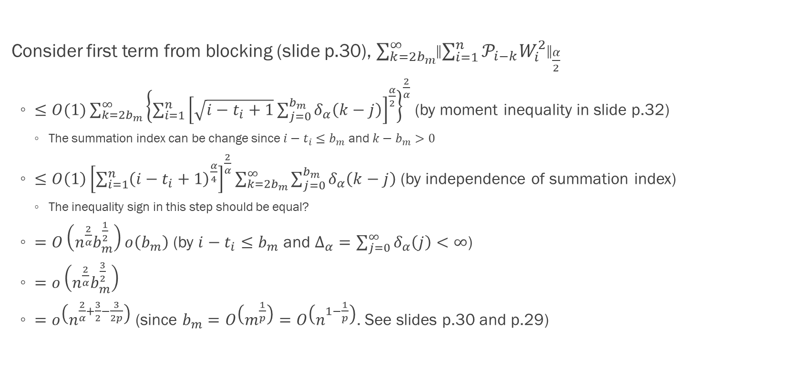
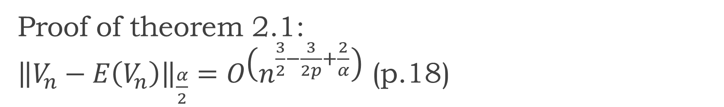
Proof of theorem 2.1: ${\left\|V_{n}−E\left(V_{n}\right)\right\|}_{\frac{α}{2}}=O\left(n^{\frac{3}{2}−\frac{3}{2p}+\frac{2}{α}}\right)$ (p.18)
Consider first term from blocking (slide p.30), $\sum_{k=2b_{m}}^{∞}{{\left\|\sum_{i=1}^{n}{𝒫_{i−k}W_{i}^{2}}\right\|}_{\frac{α}{2}}}$
$≤O(1)\sum_{k=2b_{m}}^{∞}{{\left\{\sum_{i=1}^{n}{{\left[\sqrt{i−t_{i}+1}\sum_{j=0}^{b_{m}}{δ_{α}\left(k−j\right)}\right]}^{\frac{α}{2}}}\right\}}^{\frac{2}{α}}}$ (by moment inequality in slide p.32)
The summation index can be change since $i−t_{i}≤b_{m}$ and $k−b_{m}>0$
$≤O\left(1\right){\left[\sum_{i=1}^{n}{{\left(i−t_{i}+1\right)}^{\frac{α}{4}}}\right]}^{\frac{2}{α}}\sum_{k=2b_{m}}^{∞}{\sum_{j=0}^{b_{m}}{δ_{α}\left(k−j\right)}}$ (by independence of summation index)
The inequality sign in this step should be equal?
$=O\left(n^{\frac{2}{α}}b_{m}^{\frac{1}{2}}\right)o\left(b_{m}\right)$ (by $i−t_{i}≤b_{m}$ and $Δ_{α}=\sum_{j=0}^{∞}{δ_{α}\left(j\right)}<∞$)
$=o\left(n^{\frac{2}{α}}b_{m}^{\frac{3}{2}}\right)$
$=o\left(n^{\frac{2}{α}+\frac{3}{2}−\frac{3}{2p}}\right)$ (since $b_{m}=O\left(m^{\frac{1}{p}}\right)=O\left(n^{1−\frac{1}{p}}\right)$. See slides p.30 and p.29)

Slide 34
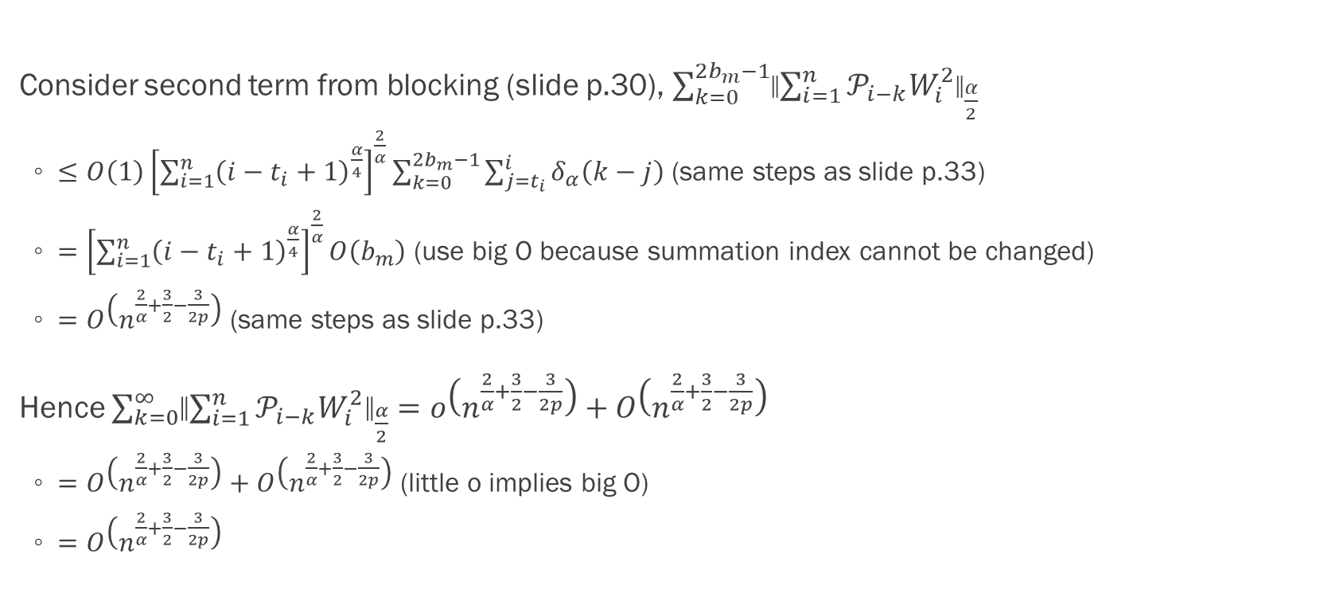
Proof of theorem 2.1: ${\left\|V_{n}−E\left(V_{n}\right)\right\|}_{\frac{α}{2}}=O\left(n^{\frac{3}{2}−\frac{3}{2p}+\frac{2}{α}}\right)$ (p.18)
Consider second term from blocking (slide p.30), $\sum_{k=0}^{2b_{m}−1}{{\left\|\sum_{i=1}^{n}{𝒫_{i−k}W_{i}^{2}}\right\|}_{\frac{α}{2}}}$
$≤O\left(1\right){\left[\sum_{i=1}^{n}{{\left(i−t_{i}+1\right)}^{\frac{α}{4}}}\right]}^{\frac{2}{α}}\sum_{k=0}^{2b_{m}−1}{\sum_{j=t_{i}}^{i}{δ_{α}\left(k−j\right)}}$ (same steps as slide p.33)
$={\left[\sum_{i=1}^{n}{{\left(i−t_{i}+1\right)}^{\frac{α}{4}}}\right]}^{\frac{2}{α}}O\left(b_{m}\right)$ (use big O because summation index cannot be changed)
$=O\left(n^{\frac{2}{α}+\frac{3}{2}−\frac{3}{2p}}\right)$ (same steps as slide p.33)
Hence $\sum_{k=0}^{∞}{{\left\|\sum_{i=1}^{n}{𝒫_{i−k}W_{i}^{2}}\right\|}_{\frac{α}{2}}}=o\left(n^{\frac{2}{α}+\frac{3}{2}−\frac{3}{2p}}\right)+O\left(n^{\frac{2}{α}+\frac{3}{2}−\frac{3}{2p}}\right)$
$=O\left(n^{\frac{2}{α}+\frac{3}{2}−\frac{3}{2p}}\right)+O\left(n^{\frac{2}{α}+\frac{3}{2}−\frac{3}{2p}}\right)$ (little o implies big O)
$=O\left(n^{\frac{2}{α}+\frac{3}{2}−\frac{3}{2p}}\right)$

Slide 35
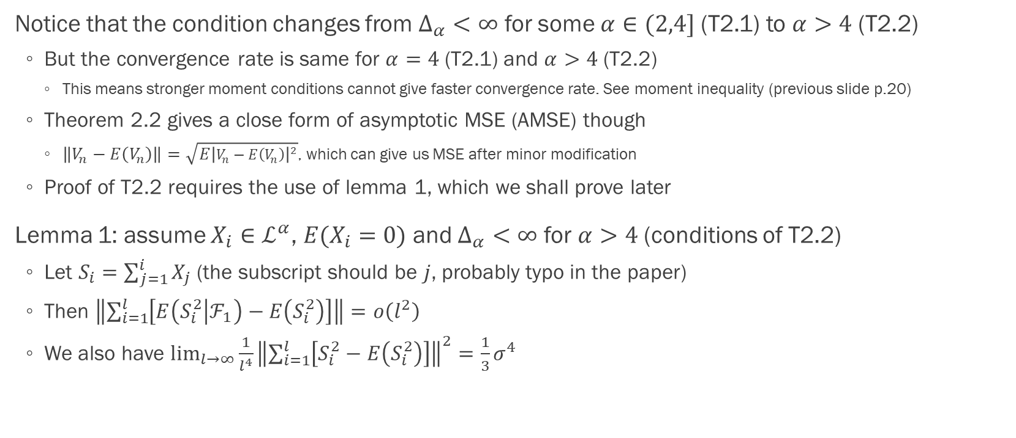

Proof of theorem 2.2: $\lim_{n→∞}{\frac{\left\|V_{n}−E\left(V_{n}\right)\right\|}{n^{2−\frac{3}{2p}}}}=\frac{σ^{2}p^{2}c^{\frac{3}{2p}}}{\sqrt{12p−9}}$ (p.20)
Notice that the condition changes from $Δ_{α}<∞$ for some $α∈(2,4]$ (T2.1) to $α>4$ (T2.2)
But the convergence rate is same for $α=4$ (T2.1) and $α>4$ (T2.2)
This means stronger moment conditions cannot give faster convergence rate. See moment inequality (previous slide p.20)
Theorem 2.2 gives a close form of asymptotic MSE (AMSE) though
$\left\|V_{n}−E\left(V_{n}\right)\right\|=\sqrt{E{\left|V_{n}−E\left(V_{n}\right)\right|}^{2}}$, which can give us MSE after minor modification
Proof of T2.2 requires the use of lemma 1, which we shall prove later
Lemma 1: assume $X_{i}∈ℒ^{α}$, $E(X_{i}=0)$ and $Δ_{α}<∞$ for $α>4$ (conditions of T2.2)
Let $S_{i}=\sum_{j=1}^{i}{X_{j}}$ (the subscript should be $j$, probably typo in the paper)
Then $\left\|\sum_{i=1}^{l}{\left[E\left(S_{i}^{2} | ℱ_{1}\right)−E\left(S_{i}^{2}\right)\right]}\right\|=o\left(l^{2}\right)$
We also have $\lim_{l→∞}{\frac{1}{l^{4}}{\left\|\sum_{i=1}^{l}{\left[S_{i}^{2}−E\left(S_{i}^{2}\right)\right]}\right\|}^{2}}=\frac{1}{3}σ^{4}$

Slide 36
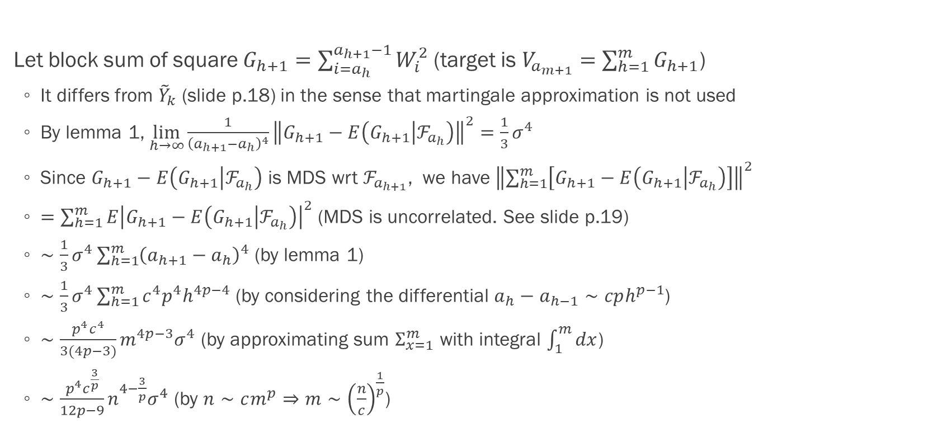
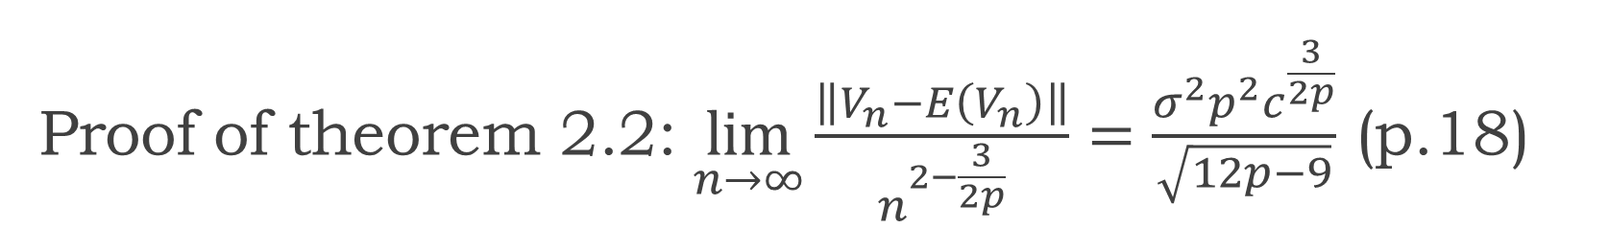
Proof of theorem 2.2: $\lim_{n→∞}{\frac{\left\|V_{n}−E\left(V_{n}\right)\right\|}{n^{2−\frac{3}{2p}}}}=\frac{σ^{2}p^{2}c^{\frac{3}{2p}}}{\sqrt{12p−9}}$ (p.18)
Let block sum of square $G_{h+1}=\sum_{i=a_{h}}^{a_{h+1}−1}{W_{i}^{2}}$ (target is $V_{a_{m+1}}=\sum_{h=1}^{m}{G_{h+1}}$)
It differs from ${\tilde{Y}}_{k}$ (slide p.18) in the sense that martingale approximation is not used
By lemma 1, $\lim_{h→∞}{\frac{1}{{\left(a_{h+1}−a_{h}\right)}^{4}}{\left\|G_{h+1}−E\left(G_{h+1} | ℱ_{a_{h}}\right)\right\|}^{2}}=\frac{1}{3}σ^{4}$
Since $G_{h+1}−E\left(G_{h+1} | ℱ_{a_{h}}\right)$ is MDS wrt $ℱ_{a_{h+1}}$, we have ${\left\|\sum_{h=1}^{m}{\left[G_{h+1}−E\left(G_{h+1} | ℱ_{a_{h}}\right)\right]}\right\|}^{2}$
$=\sum_{h=1}^{m}{E{\left|G_{h+1}−E\left(G_{h+1} | ℱ_{a_{h}}\right)\right|}^{2}}$ (MDS is uncorrelated. See slide p.19)
$∼\frac{1}{3}σ^{4}\sum_{h=1}^{m}{{\left(a_{h+1}−a_{h}\right)}^{4}}$ (by lemma 1)
$∼\frac{1}{3}σ^{4}\sum_{h=1}^{m}{c^{4}p^{4}h^{4p−4}}$ (by considering the differential $a_{h}−a_{h−1}∼cph^{p−1}$)
$∼\frac{p^{4}c^{4}}{3(4p−3)}m^{4p−3}σ^{4}$ (by approximating sum $Σ_{x=1}^{m}$ with integral $\int_{1}^{m}{dx}$)
$∼\frac{p^{4}c^{\frac{3}{p}}}{12p−9}n^{4−\frac{3}{p}}σ^{4}$ (by $n∼cm^{p}⇒m∼{\left(\frac{n}{c}\right)}^{\frac{1}{p}}$)

Slide 37
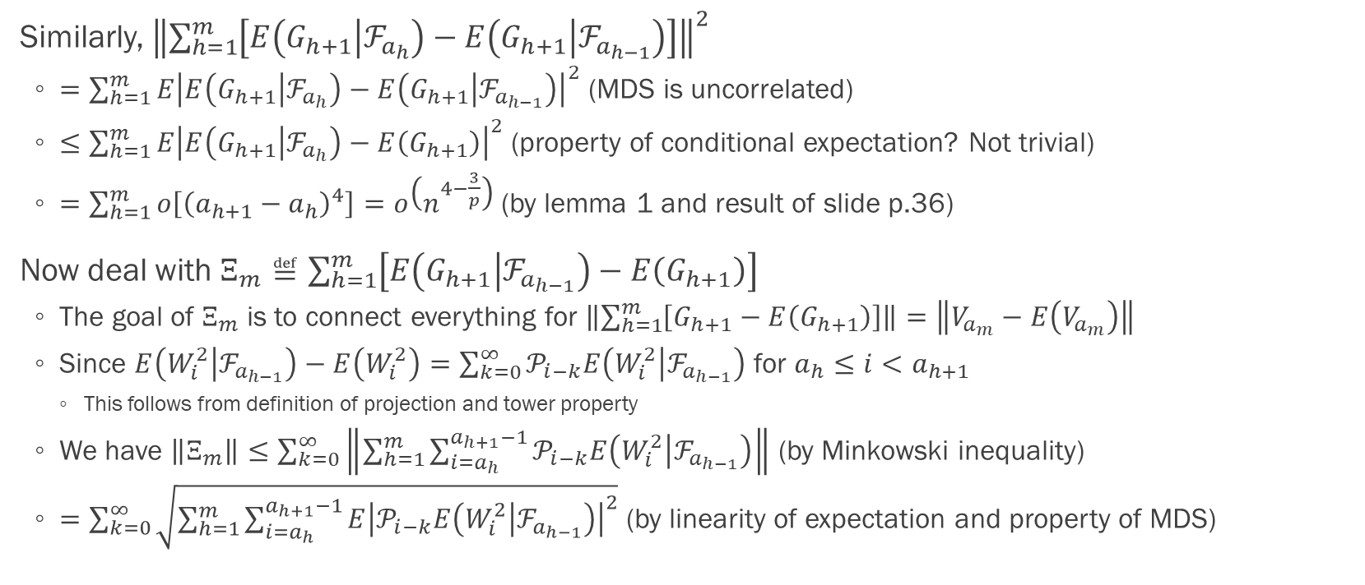
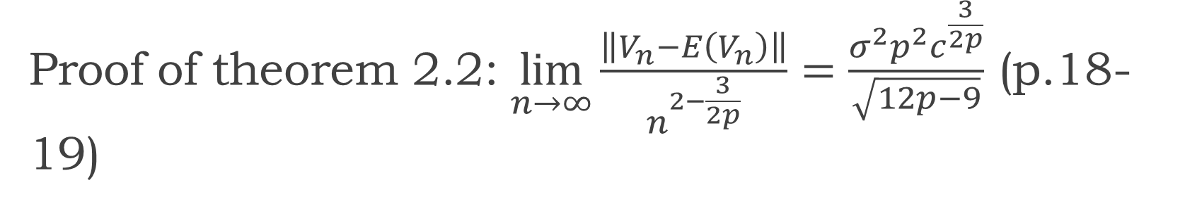
Proof of theorem 2.2: $\lim_{n→∞}{\frac{\left\|V_{n}−E\left(V_{n}\right)\right\|}{n^{2−\frac{3}{2p}}}}=\frac{σ^{2}p^{2}c^{\frac{3}{2p}}}{\sqrt{12p−9}}$ (p.18-19)
Similarly, ${\left\|\sum_{h=1}^{m}{\left[E\left(G_{h+1} | ℱ_{a_{h}}\right)−E\left(G_{h+1} | ℱ_{a_{h−1}}\right)\right]}\right\|}^{2}$
$=\sum_{h=1}^{m}{E{\left|E\left(G_{h+1} | ℱ_{a_{h}}\right)−E\left(G_{h+1} | ℱ_{a_{h−1}}\right)\right|}^{2}}$ (MDS is uncorrelated)
$≤\sum_{h=1}^{m}{E{\left|E\left(G_{h+1} | ℱ_{a_{h}}\right)−E\left(G_{h+1}\right)\right|}^{2}}$ (property of conditional expectation? Not trivial)
$=\sum_{h=1}^{m}{o\left[{\left(a_{h+1}−a_{h}\right)}^{4}\right]}=o\left(n^{4−\frac{3}{p}}\right)$ (by lemma 1 and result of slide p.36)
Now deal with $Ξ_{m}≝\sum_{h=1}^{m}{\left[E\left(G_{h+1} | ℱ_{a_{h−1}}\right)−E\left(G_{h+1}\right)\right]}$
The goal of $Ξ_{m}$ is to connect everything for $\left\|\sum_{h=1}^{m}{\left[G_{h+1}−E\left(G_{h+1}\right)\right]}\right\|=\left\|V_{a_{m}}−E\left(V_{a_{m}}\right)\right\|$
Since $E\left(W_{i}^{2} | ℱ_{a_{h−1}}\right)−E\left(W_{i}^{2}\right)=\sum_{k=0}^{∞}{𝒫_{i−k}E\left(W_{i}^{2} | ℱ_{a_{h−1}}\right)}$ for $a_{h}≤i<a_{h+1}$
This follows from definition of projection and tower property
We have $\left\|Ξ_{m}\right\|≤\sum_{k=0}^{∞}{\left\|\sum_{h=1}^{m}{\sum_{i=a_{h}}^{a_{h+1}−1}{𝒫_{i−k}E\left(W_{i}^{2} | ℱ_{a_{h−1}}\right)}}\right\|}$ (by Minkowski inequality)
$=\sum_{k=0}^{∞}{\sqrt{\sum_{h=1}^{m}{\sum_{i=a_{h}}^{a_{h+1}−1}{E{\left|𝒫_{i−k}E\left(W_{i}^{2} | ℱ_{a_{h−1}}\right)\right|}^{2}}}}}$ (by linearity of expectation and property of MDS)

Slide 38
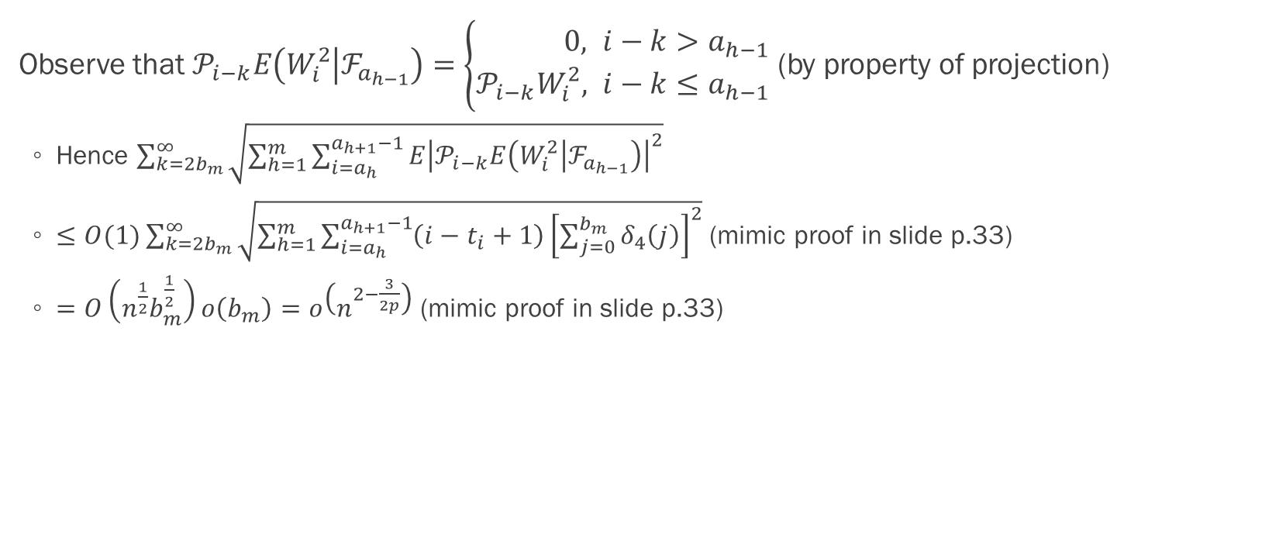

Proof of theorem 2.2: $\lim_{n→∞}{\frac{\left\|V_{n}−E\left(V_{n}\right)\right\|}{n^{2−\frac{3}{2p}}}}=\frac{σ^{2}p^{2}c^{\frac{3}{2p}}}{\sqrt{12p−9}}$ (p.19)
Observe that $𝒫_{i−k}E\left(W_{i}^{2} | ℱ_{a_{h−1}}\right)=\left\{\begin{aligned}0&, i−k>a_{h−1} \\ 𝒫_{i−k}W_{i}^{2}&, i−k≤a_{h−1}\end{aligned}\right.$ (by property of projection)
Hence $\sum_{k=2b_{m}}^{∞}{\sqrt{\sum_{h=1}^{m}{\sum_{i=a_{h}}^{a_{h+1}−1}{E{\left|𝒫_{i−k}E\left(W_{i}^{2} | ℱ_{a_{h−1}}\right)\right|}^{2}}}}}$
$≤O(1)\sum_{k=2b_{m}}^{∞}{\sqrt{\sum_{h=1}^{m}{\sum_{i=a_{h}}^{a_{h+1}−1}{\left(i−t_{i}+1\right){\left[\sum_{j=0}^{b_{m}}{δ_{4}\left(j\right)}\right]}^{2}}}}}$ (mimic proof in slide p.33)
$=O\left(n^{\frac{1}{2}}b_{m}^{\frac{1}{2}}\right)o\left(b_{m}\right)=o\left(n^{2−\frac{3}{2p}}\right)$ (mimic proof in slide p.33)

Slide 39
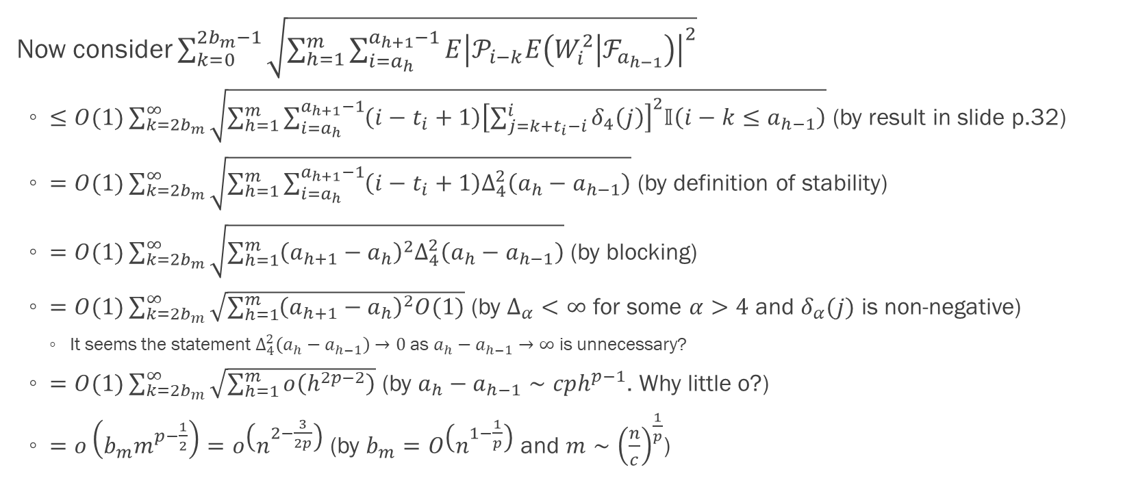
Proof of theorem 2.2: $\lim_{n→∞}{\frac{\left\|V_{n}−E\left(V_{n}\right)\right\|}{n^{2−\frac{3}{2p}}}}=\frac{σ^{2}p^{2}c^{\frac{3}{2p}}}{\sqrt{12p−9}}$ (p.19)
Now consider $\sum_{k=0}^{2b_{m}−1}{\sqrt{\sum_{h=1}^{m}{\sum_{i=a_{h}}^{a_{h+1}−1}{E{\left|𝒫_{i−k}E\left(W_{i}^{2} | ℱ_{a_{h−1}}\right)\right|}^{2}}}}}$
$≤O(1)\sum_{k=2b_{m}}^{∞}{\sqrt{\sum_{h=1}^{m}{\sum_{i=a_{h}}^{a_{h+1}−1}{\left(i−t_{i}+1\right){\left[\sum_{j=k+t_{i}−i}^{i}{δ_{4}\left(j\right)}\right]}^{2}𝕀\left(i−k≤a_{h−1}\right)}}}}$ (by result in slide p.32)
$=O(1)\sum_{k=2b_{m}}^{∞}{\sqrt{\sum_{h=1}^{m}{\sum_{i=a_{h}}^{a_{h+1}−1}{\left(i−t_{i}+1\right)Δ_{4}^{2}\left(a_{h}−a_{h−1}\right)}}}}$ (by definition of stability)
$=O(1)\sum_{k=2b_{m}}^{∞}{\sqrt{\sum_{h=1}^{m}{{\left(a_{h+1}−a_{h}\right)}^{2}Δ_{4}^{2}\left(a_{h}−a_{h−1}\right)}}}$ (by blocking)
$=O(1)\sum_{k=2b_{m}}^{∞}{\sqrt{\sum_{h=1}^{m}{{\left(a_{h+1}−a_{h}\right)}^{2}O(1)}}}$ (by $Δ_{α}<∞$ for some $α>4$ and $δ_{α}(j)$ is non-negative)
It seems the statement $Δ_{4}^{2}\left(a_{h}−a_{h−1}\right)→0$ as $a_{h}−a_{h−1}→∞$ is unnecessary?
$=O(1)\sum_{k=2b_{m}}^{∞}{\sqrt{\sum_{h=1}^{m}{o\left(h^{2p−2}\right)}}}$ (by $a_{h}−a_{h−1}∼cph^{p−1}$. Why little o?)
$=o\left(b_{m}m^{p−\frac{1}{2}}\right)=o\left(n^{2−\frac{3}{2p}}\right)$ (by $b_{m}=O\left(n^{1−\frac{1}{p}}\right)$ and $m∼{\left(\frac{n}{c}\right)}^{\frac{1}{p}}$)

Slide 40
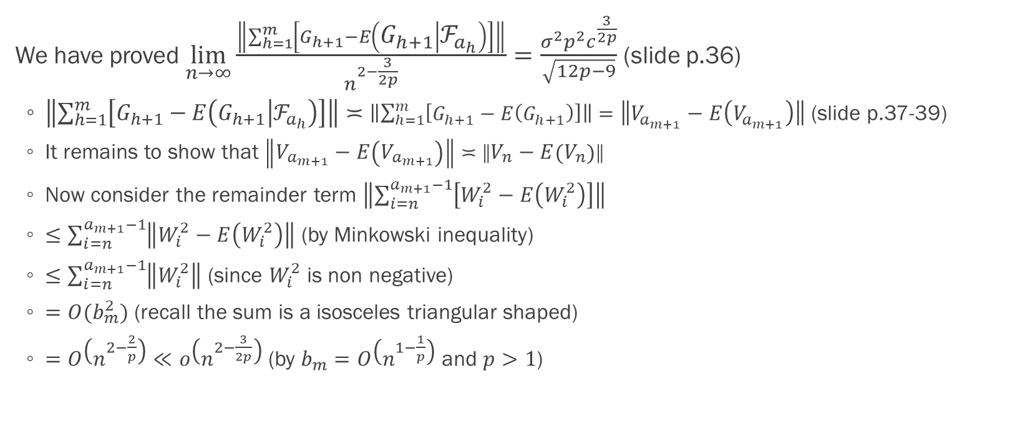
Proof of theorem 2.2: $\lim_{n→∞}{\frac{\left\|V_{n}−E\left(V_{n}\right)\right\|}{n^{2−\frac{3}{2p}}}}=\frac{σ^{2}p^{2}c^{\frac{3}{2p}}}{\sqrt{12p−9}}$ (p.19)
We have proved $\lim_{n→∞}{\frac{\left\|\sum_{h=1}^{m}{\left[G_{h+1}−E\left(G_{h+1} | ℱ_{a_{h}}\right)\right]}\right\|}{n^{2−\frac{3}{2p}}}}=\frac{σ^{2}p^{2}c^{\frac{3}{2p}}}{\sqrt{12p−9}}$ (slide p.36)
$\left\|\sum_{h=1}^{m}{\left[G_{h+1}−E\left(G_{h+1} | ℱ_{a_{h}}\right)\right]}\right\|≍\left\|\sum_{h=1}^{m}{\left[G_{h+1}−E\left(G_{h+1}\right)\right]}\right\|=\left\|V_{a_{m+1}}−E\left(V_{a_{m+1}}\right)\right\|$ (slide p.37-39)
It remains to show that $\left\|V_{a_{m+1}}−E\left(V_{a_{m+1}}\right)\right\|≍\left\|V_{n}−E\left(V_{n}\right)\right\|$
Now consider the remainder term $\left\|\sum_{i=n}^{a_{m+1}−1}{\left[W_{i}^{2}−E\left(W_{i}^{2}\right)\right]}\right\|$
$≤\sum_{i=n}^{a_{m+1}−1}{\left\|W_{i}^{2}−E\left(W_{i}^{2}\right)\right\|}$ (by Minkowski inequality)
$≤\sum_{i=n}^{a_{m+1}−1}{\left\|W_{i}^{2}\right\|}$ (since $W_{i}^{2}$ is non negative)
$=O(b_{m}^{2})$ (recall the sum is a isosceles triangular shaped)
$=O\left(n^{2−\frac{2}{p}}\right)≪o\left(n^{2−\frac{3}{2p}}\right)$ (by $b_{m}=O\left(n^{1−\frac{1}{p}}\right)$ and $p>1$)

Slide 41
Proof of lemma 1 (p.20)
TBC

